Slide 1
Class consciousness and disempowerment of Chinese migrant workers in transitional communities:
Why does it matter for Chinese communities in UK?
Dr. Bin Wu (武斌)
Centre for Chinese Migration Studies (CCMS)
School of Contemporary Chinese Studies
University of Nottingham

Slide 2
Content
Background and rationale
Methodology of empirical studies
Class consciousness: dimension and evidence
Disempowerment: key factors
Conclusion and implications

Slide 3

Why this topic? Pope Francis visit to Prato (10/11/15) and a fire tragedy (1/12/2013)
Prato: “Italy’s little China”, 16,000/40,000/186,000
Uncontrolled immigration and modern slavery
http://www.bbc.co.uk/news/world-europe-25180500
Tension between Chinese and local residents

Slide 4
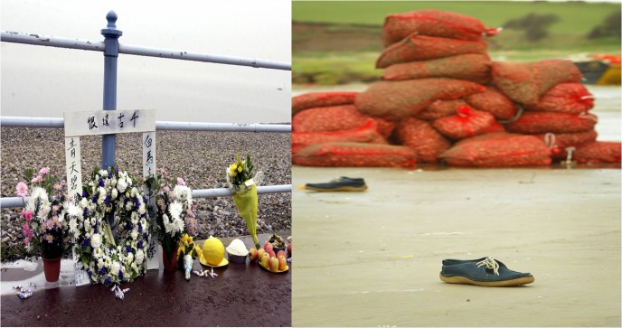
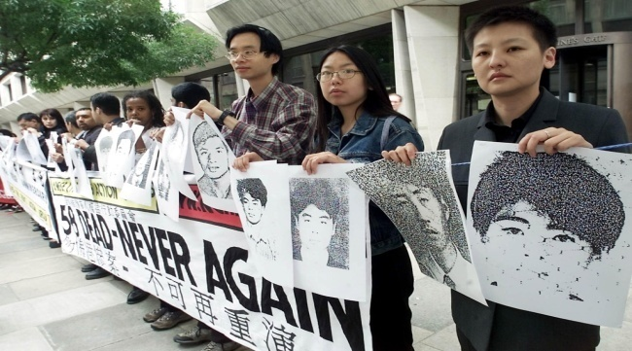
What do we learn from tragedies?
(2013 Prato, 2004 Morecambe, 2000 Dova)
Spread of sweatshops in the era of global capitalism
International migration/integration for what and whom
Responsibilities of diasporic communities & host society
Voices and rights of Chinese migrant workers, who care?

Slide 5
Chinese communities in the UK
Expansion of Chinese population & student migration
Segmentation, fragmentation and segregation
Large amount of irregular migrant workers
Isolation and vulnerability of Chinese workers

Slide 6
Understanding Chinese migrant workers: Perspectives and limitations
Poor human capital (“segmented assimilation”)
Costs for entrepreneurship (“self exploitation”)
Cultural shock (“transnational identity”)
Institution barriers (call for “Amnesty”)

Slide 7
Empowering migrant workers in China: two approaches
Marxism: structure, consciousness, collective action
Weberian: stratification, income, skills and education
Nightmare of “class struggle” and political sensitive for labour movement and labour studies in China

Slide 8
Journey of my research
Working conditions and voices of Chinese seafarers to join international trade union (2004-2007)
Working conditions of Chinese migrant workers in Veneto, Italy and East Midlands, UK (2006-2010)
Diasporic Chinese communities and roles of universities in Chinese community cohesion integration (2010 to 2015)

Slide 9
Research questions
To what extent do Chinese migrant workers in Italy and the UK have class consciousness?
Why is the class consciousness weaker in the UK than in Italy?
What are key factors against the formation and spread of class consciousness?
Implications for global universities and Chinese students’ engagement?

Slide 10
Figure 1 Research framework
Community
Structure
Employment
Environments
Collective Identity
Awareness & rights
Collective Actions
Class Consciousness
Workers'
Network
Empowerment if overall results positive;
Disempowerment if overall results negative

Slide 11
Fieldwork methods
Two-tiers: workplace observations and interviews
Sampling: random and “snowball”
Theme: common interests
Stakeholders’ participation
LSE Blog (Wu, 2014): Embedding research in local contexts: local knowledge, stakeholders’ participation and fieldwork design

Slide 12
Collective identity
Terminology: Laoban (boss) vs. Dagongzhai (worker)
Experience comparison: Chinese and Italian workplace
Representatives of Chinese community organisations
Retention and royalty related to the respect

Slide 13
Labour exploitation and abuses
Poor working conditions against local regulations;
Labour exploitations and abuses against their rights;
Key factors and evidence behind
Demanding for Job in Italian owned factories
Long working hours and low pay in the UK
Exploitation by hometown mate
Deposit as control means

Slide 14
Forced labour amongst legal migrant workers
Wrong assumption about cause by migration status
Work permit holders: both chefs and TCM doctors
Process of force labour in our samples
Profit making from the beginning
Personal documents and large deposit taken
Dependency on employers until permanent status

Slide 15
Workers’ responses: actions
Searching legal protection individually
“Vote by foot” for better working conditions
“Strike” and fighting with “evil boss”
Contacting and joining local trade unions
“Bringing class back in: class consciousness and solidarity among Chinese migrant workers in Italy and the UK”, Ethnic and Racial Studies, 2014, 37(8): 1391-1408.

Slide 16
Tab.1 Case of Nottingham Chinese community
(UK Census 2001, 2011)
Item | Chinese |  | % of all population |  | Growth
 | 2011 | 2001 | 2011 | 2001 | 2011/2001
Nottingham city | 5988 | 1715 | 1.96 | 0.64 | 3.49
Nottinghamshire | 2942 | 2014 | 0.37 | 0.27 | 1.46
Nottingham total | 8930 | 3729 | 0.82 | 0.37 | 2.39
National total | 379,503 [2.35%] | 220,150 [1.69%] | 0.72 | 0.45 | 1.72

Slide 17
Tab. 2 Nott Chinese community surveys
Item | 2002 | 2013
Theme of survey | Quality of life | Community cohesion
Samples: Size | 620 | 311
Students (%) | 48.1% | 52.1%
From China | 39.6% | 70.0%
Hong Kong | 39.1% | 13.4%
Female | 51.8% | 64.3%
Age 18 to 24 | 32.9% | 44.9%
>10 yrs in Nott | 30.8% | 14.7%

Slide 18
Tab. 3 Knowing community organisation?
Name of organisation | 2013 | Resident | Student | 2002
East England Chinese Association | 21.2 | 38.3 | 5.6 | 54.0
Nottinghamshire Chinese Welfare Association | 20.9 | 30.2 | 12.3 | 43.1
Chinese Students and Scholars Association | 50.2 | 47.0 | 53.1 | --
School of Contemporary Chinese Studies | 41.5 | 34.2 | 48.1 | 10.2

Slide 19
Tab. 4 Awareness of community events (%)
Name of event | Know | Participate | Resident | Student
Chinese Spring Festival Gala | 62.4 | 22.8 | 55.7 | 68.5
Chinese Community Events | 38.6 | 5.8 | 29.5 | 46.9
Community organised tourism | 36.7 | 7.7 | 25.5 | 46.9
Local Church activities | 37.0 | 8.0 | 23.5 | 49.4
University Community Open Day | 40.5 | 5.5 | 27.5 | 52.5
Local cultural festivals | 30.2 | 5.8 | 26.8 | 33.3

Slide 20
Tab. 5 Social network of local residents
Job type | Chinese 1 | Chinese 2 | Chinese 3 | Non-Chinese | Total
 | S. dialect | diff dialect | diff identity | other ethnic
Similar | 45.0 | 28.2 | 23.5 | 24.2 | 120.9
Different | 26.2 | 21.5 | 26.8 | 20.1 | 94.6

Slide 21
Tab. 6 Ownership in catering (Notts 2009)
Region of origin | Mean Years | No. | % of Total N
Dongbei | 2.40 | 5 | 12.5
Fujian | 3.08 | 13 | 32.5
Other region | 4.00 | 6 | 15.0
Hong Kong | 8.54 | 13 | 32.5
Other Chinese | 12.33 | 3 | 7.5
Total | 5.60 | 40 | 100

Slide 22
Transnational network and competition
There is a surplus of labour forces of Chinese doctors than needed across the UK. Hence, this causes mal-competition. There are about 2000 managers/sub-managers, 5000-6000 Chinese doctors in the field of Chinese medicine in the UK. Each year, there are labour brokers who work in importing Chinese doctors who wants to come to the UK to pay RMB 80,000 (£8000). The labour broker keeps half of the money, and gives half to the employer. There are ties between employers and labour brokers. Due to the surfeit of labour force and paucity of labour needs, Chinese doctors pick up the jobs which pay £400-700/month. It’s dreadful. Chinese doctors are exploited by overseas Chinese clinic employers. (Interview 18, 49 years old)

Slide 23
Complexity of Chinese migrant workers
Glasgow is a nice city but the working staffs in the kitchen were really not good. They all are from a province with only 2-3 years of primary school education. Their working style is really untrained and unacceptable. For example, there is a rubbish bin in the kitchen, which is for rubbish, can you pour wasted water into the same rubbish bin? When I threw the bin bag, it was always broken due to the water, which was really hard for me to do that, I am not afraid you laugh at me, when my friends in China asked me who I was working with, I told them I was working with a group of animals. I have to say they are all peasants. I used to do management in factory in China, so now in kitchen when they asked me to do things, I feel uncomfortable, how dare they ask me to do things! (Interview 10, irregular, male, 37 years old)

Slide 24
Regional discrimination
What I want is to be respected as a Human Being, a respectable Chinese......One issue in many Chinese restaurants is bully. In my previous restaurant, there were 11 workers, two Dongbeinese, one Shanghainese, 8 Fujianese. Fujianese is the most united group I have ever seen but they bullied on us. For example, they kept “borrowing” money from a guy more than 10,000 pounds, and if you ask when their return of the borrowed money, they will answer your money will be returned after we die. it is really torture to him.
A Shanghai young guy came here, and had his passport taken away from the airport by the boss, and only paid him £150 per week for his work, moreover, you have to obey the boss’s order, or you will be fired without any reason or with any reason. …….That is why I want to organise Chinese workers together and to be united, as I feel we have less power if separated. (Interview 17)

Slide 25
Disempowerment: factors and processing
Transnational Network
C/L mobility
Competition
Ir. workers
Job security
Worker network
Community transition
Rural-urban
Student migration
Education
Occupation
Stratification
Fragmentation
Regional
D. organisation

Slide 26
Conclusion and implications (1)
Generally, poor working conditions and vulnerability of Chinese migrant workers, which are caused by many factors, represent low level of Chinese community cohesion and integration
Against labour exploitation and social powerless, class consciousness is an important for not only Chinese migrant workers to develop their collective identity, awareness and actions to protect their rights, but also host society to understand, empower and help them for better integration.
The existence and functions of class consciousness cannot be overestimated as many factors influencing the formation and spread of class consciousness among Chinese migrant workers.

Slide 27
Conclusion and implications (2)
Our research in East Midlands suggests that disempowerment against class consciousness in the UK is related to many factors: transnational network for capital and labour mobility, Chinese community transition driven by Chinese student migration, fragmented workers’ network caused by rural-urban division and other factors in China
Compared with in our empirical study in Italy, weak class consciousness in the UK is related to many factors: shortage of regular labourers, government migration policy, dysfunction of traditional Chinese organisation
Disempowerment identified is also related to both the disconnection with the wider society, and fragmentation inside caused by many factors before international migration

Slide 28
Conclusion and implications (3)
The responsibilities of global universities for diasporic Chinese community cohesion and integration, positive impact on empowering Chinese migrant workers.
For empowerment process, a potential intervention point is mobilising and organising volunteer students to participate and contribute to local Chinese community projects, which is dependent upon many other conditions, including global citizenship education, university mission and commitment
This research calls for bringing class back in international migration and diaspora studies, to take into account suffering, voices, needs and potential of Chinese migrant workers.

Slide 29
Promotion
Joint publication: The International Journal of Diaspora Chinese Studies (《华人研究国际杂志》)
Edited volume: Chinese Higher Education Reform and Social Justice (by Bin Wu and John Morgan, Routledge, 2016)
Special Issue of the Journal of Chinese Overseas:
Chinese student integration and local engagement (Guest editors: Bin Wu and Stig Thøgersen, 2016)

Slide 30
MANY THANKS!

