Slide 1
Rural Romania, Medical Care During the Pandemic
By dr Ágnes Neményi

Slide 2
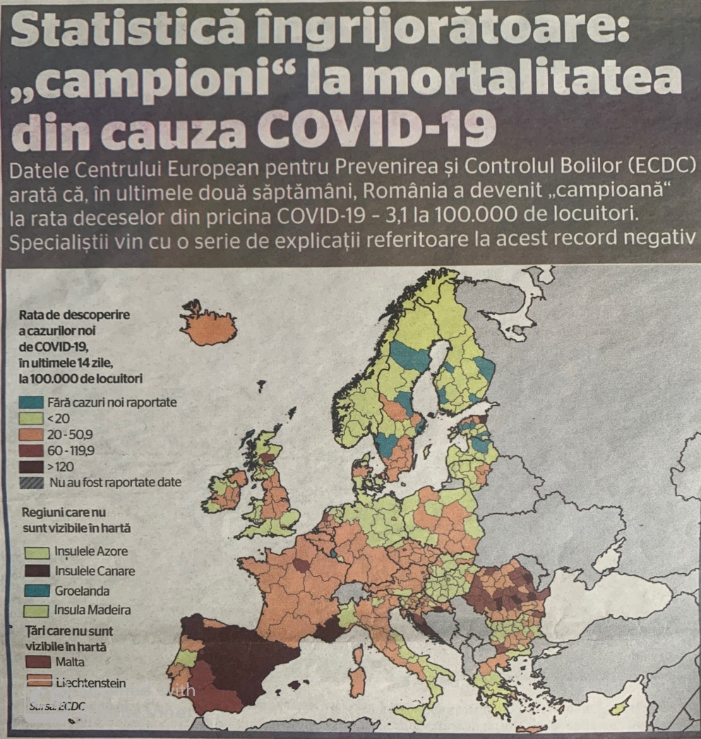
2020
ECDC

Slide 3
In 2020 was presented a statistics of ECDC , where Romania has the highest rate of death, 3,1 from 100.000 inhabitants (European Center of Disease Control ) caused by Covid-19
Other countries as Bulgaria had 1,6 rate, Spain with 1,0 rate of death.
Asked three doctors about the motives of high death rate, they said :
In Romania patients with sever chronic disease are not correctly evaluated in time,
-These pacients contacting Covid- 19 has a worst evolution of case,
- The monitoring of those pacients with easier evolution which is becoming worst later is linked by a slow intervention of the medical care system.

Slide 4
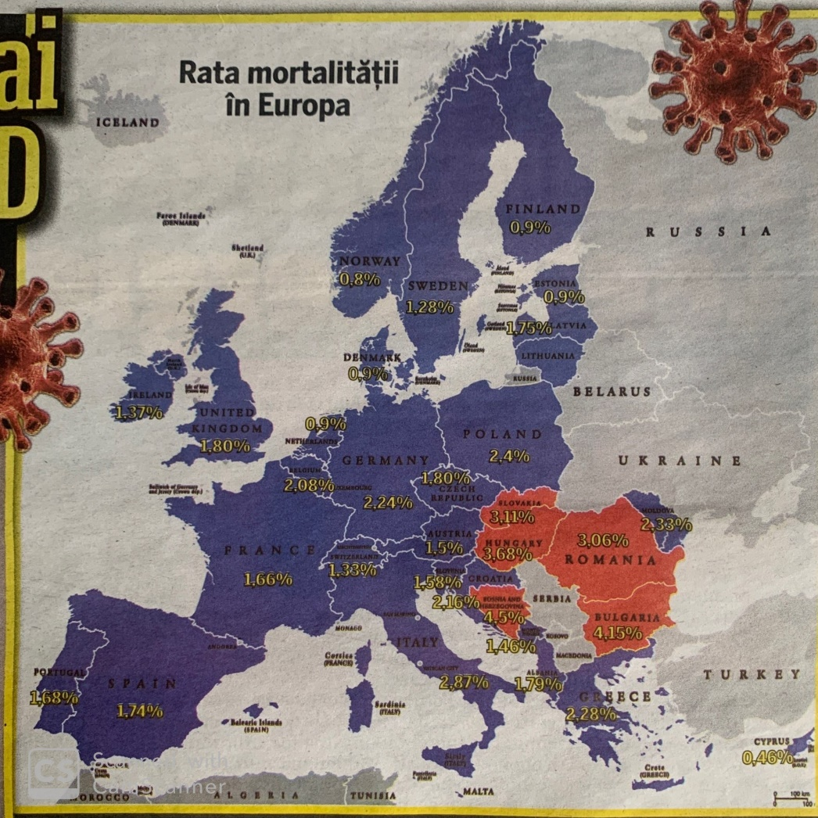
2021
Mortality rate in
Europe

Slide 5
-In 2021 the death rate of Romania was maintaining 3,03 %. Higher rates were in Slovakia ( 3,11 % ), Hungary (3,68 % ), Bulgaria ( 4,15 %), and Bosnia Hertegovina ( 4,5 % ).
-The lowest rate of mortality ( September 2021 ) was in Cyprus ( 0,46 % ) Sweden (1,28%), Switzerland (1,33%), Ireland ( 1,37 % ), Monte-Negru (1,46%),… In Romania are 7 times more death events then in Cyprus.
-Over 2 % of death rate are : Belgium ( 2, 08 %), Croatia (2,16 %), Germany ( 2,24 %), Greece ( 2,28 % ), R. Moldova (2,33 % ).
- The motives are linked by vaccination level, which is low in Romania, so the mortality rate remained at the same high level ( of 2020 ).

Slide 6
Mortality in excess
1th of March 2020
28 of Nov. 2021

Slide 7
In January 2022 the official date indicated 5,5 million death of Covid-19 at world level. The review Nature published the results of a research which shows that the number of death from 2020 is 4 times higher. This excess of death is calculated as difference between the registrated death events and based on predicted dates of similar period from the past. There are presented two studies :
- one with 18 million death events in plus indicated from Institute of Health Metrics and Evaluation from Washington, USA,
- and an other with 22 million death events in plus of the review
The Economist from London.

Slide 8
In the graph of The Economist Romania is on 7th place in the world with 112.880 death in excess in correlation with Covid-19 in the period 30 March 2020- 28 November 2021. Officially were registrated 56.230 death of Covid-19. On the first place of death not beforehand in advance is Bulgaria, next is Serbia and Russia.
The graph offered by ourworldindata.org shows that before the pandemia at the 1st of March 2020 death rate was negative.
There were dieing less people then a year ago with 6 %. In November 2020 the death were more with 68 %, and in October 2021 the mortality grew with 129 %.
Source : Libertatea, 3 of February, 2022, p.9.

Slide 9
The situation of medical personnel
The quality of medical care was influenced from 2020 by the appearance of Covid19, because a lot of medical units were concentrated exclusively on pandemic disease and in this time other chronic diseases were postponed a long time. After a year these units returned to the original practices. So, it was a considerable time, when persons with chronic disease couldn’t have access to medical services.
An other problem in medical care activity was the migration of doctors and assistances. In 2020 daily 5,95 doctors were leaving the country. In that year 2173 doctors leaved Romania.

Slide 10
As the statistics show:
in 2018 2312 doctors leaved the country
in 2019 3015 “
From Bucharest in 2019 migrated 607 doctors
in 2020 “ 491 “
From Timis county in 2019 migrated 411 doctors
in 2020 “ 364 “
From Iasi county in 2019 and 2020 migrated 751 doctors

Slide 11
In 2021 the number of medical personnel was :
55.000 doctors
17.000 dentists
18.000 pharmacists
50 % of doctors ( 30.000 ) are concentrated in Bucharest, Dolj, Timis, Cluj, Mures and Iasi county, where the medical infrastructure is satisfactory.
But also 80 % of medical personnel is working in urban settlements.

Slide 12
The Good Standing Certification is made by the Medical Chamber to those medical persons who want to practice abroad. We present the number of them in last years :
In 2016 were 1462 people applying to GSC
in 2017 1374 “
in 2018 1221 “
in 2019 1099 “
in 2020 858 “
in 2021 776 “
There is a decreasing tendency
In the country there are over 2500 communes, with 13.000 villages.
In 500 communes there are missing doctors and medical services.

Slide 13
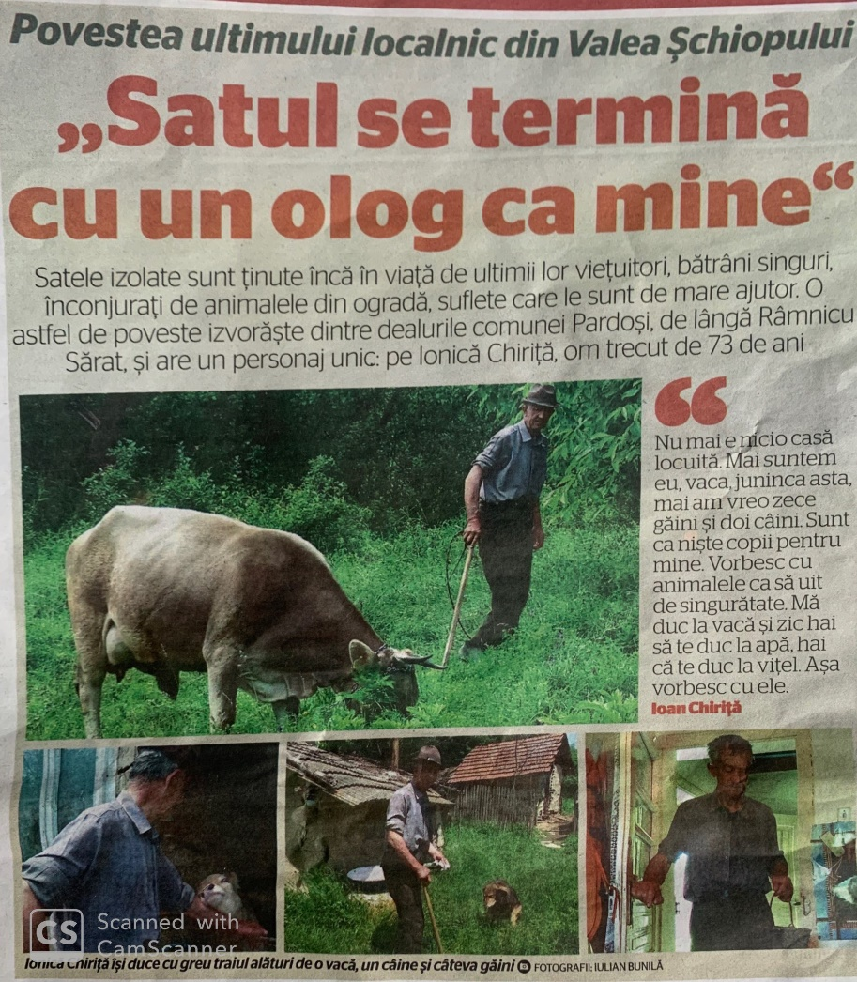
Village with single inhabitant.
The person sais:
I am with the cow, ten chicken and two dogs. 73 years man, near Ramnicu Sarat

Slide 14
Over 43 % of the population is living in rural areas. These villages has older population with small pensions. The agricultural pension is 1000 lej ( 200 euro ).
The rural population is old, poor, without medical care access, they have no medical assurance ( medical card ).
Case Study 1
In 2020 at the beginning of pandemia Covid 19 a little group of young doctors from Bucharest made a visit in a village in Ialomita county ( Baragan region ) influenced by a Denish institution.

Slide 15
In that weekend day there were made 200 health examinations on local population, persons over 50 years and older. Made also laboratory examinations. On half of them found chronic diseases, about what the persons didn’t know , not at all- diabet, hepatitis, heart disease, nephritis, cancer.
It was also a 71 years old man who made first time in his life a medical examination.
This case study show a common situation in countryside in Romania.

Slide 16
Index of Social Progress, 2021 ( Co. Deloitte )
The study “ Index of Social Progress 2021 “ about the quality of life and social wellbeing put Romania on the 44th place from 168 countries, with 78,41 points from 100.
Index of Social Progress ( IPS ) is measuring quality of life of citizen in 168 countries based on three dimentions :
- basic needs, as food, basic medical care, water and public health, home and personal security.
- wellbeing, access to basic education, access to information and communication, health, wealth, quality of environment.

Slide 17
- the third item is opportunities, as personal rights, personal liberty and voting, social inclusion, access to higher education.
The countries were divided in 6 groups depending by results.
In 2021 on the first place is Norway, Finland, Denmark, on the last places are Ciad, R. Centrafrika, South Soudan.
From the EU: Finland ( 2 ), Denmark ( 3 ), Sweden ( 7 ) are countries with the highest quality of life
From Central and East Europe the best place has Estonia ( 21 ), Chech Republic ( 22), Slovenia ( 26 ), Lituania ( 27 ), Slovakia ( 33 ),

Slide 18
Letonia (34), Poland (35), Croatia (36), Hungary (42), Bulgaria (43), Romania (44).
Romania is situated by basic needs on place 41, by opportunities on place 45, by wealth on place 50.
Romania has better place in access to communication (35),
Personnel safety (38), personal rights (41), and access to higher education (43).
Lowest places are of inclusion (85), health and wellbeing (81), access to basic education (73).
Source : Adevarul 24 November 2021, p.6). www.adevarul.ro

Slide 19
Decentralization of some hospitals from towns, which were transformed as administrative units of big county hospitals (2011).
Case study 2
Hospital of town Darabani and Saveni, Botosani county.
These hospitals were becoming in 2011 sections of county hospital of Botosani. If these local hospitals become units with own juridical status can apply for EU project, to be modernized. They serve
50.000 people from rural regions. There are other small hospitals in the same situation.

Slide 20
Case study 3
Sarmas, Mures county
There is a locality on the limit of three counties : Mures, Cluj and Bistrita-Nasaud. The local hospital was closed in 2011 (with other 65 other town hospitals). The local people has to travel 42 km to the nearest hospital of Ludus. Now there are plans for reopening the local hospital with EU money.
Source : Kronika, 3 of February 2022, p 8.www.KRONIKAONLINE.ro

Slide 21
CONCLUSIONS
The medical care system in Romania is based on big inegalities, some made by Covid -19, but the most important are linked by rural-urban differences. Rural population has access to medical care only near the big cities.
The migration to other countries of the medical personnel was very high in last years, now is diminished, thanks to the higher wages of them, but the number of medical personnel is missing too.
The medical care system can be developed by making better conditions in rural settlements, developing micro-medical centers (medical infrastructure, other facilities).

