Slide 1
The Finance Foundation
Is age a factor in financial exclusion?
How the older old manage their daily finances in today’s increasing digital world
Presentation to Oxford Institute of Population Ageing
10th November 2016

Slide 2
The Finance Foundation
An independent think tank that aims to encourage informed debate about financial services, explain what the sector does, and suggest ways it could work more effectively.
We do this by undertaking research and publicising the results to inform and influence the relevant stakeholders; and by hosting public debates and events to help bring issues about the future of financial services into the open.
Originally established as Demos Finance, the current not for profit company was formed in 2014. It is not a lobby group and has no political affiliation.
www.thefinancefoundation.org.uk

Slide 3


Key People
Andrew Freeman - Director - former Director of Demos Finance, was also the Managing Director of Cambridge Research Associates, which provided research and thought leadership for professional services firms, and is the founder of the website Fairer Finance. He was previously Executive Director at the Centre for Financial Services at Deloitte and a founder member of McKinsey & Company’s risk practice. A Risk Fellow at the Cambridge Judge Business School, Andrew is a former banking editor of the Economist and a regular media commentator. In 2013, he wrote the report 'Finance for Growth', for Demos and in 2014 launched the first Finance Foundation report, 'Heroes or Zeros'.
Hilary Cooper - Senior Associate - after completing a masters in economics, followed by a short period as a banking intern, Hilary worked for more than 20 years as a government economist and senior policy maker across a wide range of government departments, and served as an adviser and trustee of the youth charity Theatre Is... from 2008-12. Author of the Bluffer's Guide to Economics, and occasional feature writer, she has pursued a freelance career since leaving the civil service in 2011. During this time she also set up an on-line business to support mature carers, and in early 2014 published 'Putting Customers First' a report on retail finance regulation for Demos Finance, where she was a senior associate researcher.

Slide 4
New Research – September 2016
“When I’m 84.”
Locking the Door on the Older Old:
the Challenge Facing Britain’s Banks.
Hilary Cooper

Slide 5
Structure of talk
Why we chose to focus our research on people in their 80s and 90s
Discussion of financial exclusion and the way it may impact in older age
Overview of the findings from our empirical work
Consideration of the wider context affecting older people and their access to financial services
Concluding remarks/recommendations

Slide 6
Researching the Older Old (80+)
The older old – those aged 80 and over – are the fastest growing section of the population. Currently just over 3 million, this will increase to 3.5 million by 2020 and 5 million by 2030, of whom 1 million will be over 90
Much of the research done on older people, however, looks at all those above retirement age - risking missing the distinctive challenges faced by those in their 80s and 90s
Where online and phone surveys are used, these are not well-suited to accessing a broad sample of the over 80s, although alternatives are expensive and more challenging
Given our hypothesis that the risk of financial exclusion increases with age, we decided to tackle these issues head on, commissioning face-to-face interviews with people in their 80s and 90s and supplementing this with an online survey of informal carers

Slide 7
Research Objectives
To identify the challenges faced by people aged 80 and over in managing their day to day finances e.g. paying bills, taking out cash and keeping track of money and to include the perspective of those who provide informal care and support to them (generally family members);
To conduct original research – collecting both qualitative and quantitative data from older people and their carers - on the nature and extent of the problems and barriers encountered, whether this be due to physical and sensory impairment, poor capability, exclusion from mobile and digital access or more general vulnerability to poor conduct or even fraud;
To draw out key findings and make recommendations for the industry and policy makers on the changes that need to be made now in order to future proof financial services provision as we enter a period of unprecedented growth in the population aged 80 and over.

Slide 8
Methodology
Fieldwork was carried out in October/November 2015 by Opinium Research
Phase 1 – Qualitative
Focus group work with people aged 80 and over plus a small number of one to one interviews with carers to explore issues in depth and help frame the questionnaires
Phase 2 – Quantitative
175 structured face-to-face interviews around the country with people aged 80+, mostly in their home. Gender split was 60:40 females to males. Age split was roughly 50% 80-84 and 50% 85+ (including 9% over 90)
255 completed forms from those providing informal care (non-spouse and under 75 only), recruited from Opinium Research’s online panel
Both surveys excluded older people with dementia or who were living in a residential home and those for whom an active LPA was in use.

Slide 9
Areas covered – Older people interviews
Use of and preference for different types of transaction – cash, cheque or card, phone, online, face to face or machine
How they accessed cash and dependence on others for this
Use of and views on the pros and cons of different methods of accessing cash such as ATM and over the counter
Use of and attitudes to credit
Use of technology as an aid to financial management, including reasons for non-use
Importance of cash and its role in helping with budgeting and keeping track of spending
Changes that they would like to see that would make managing their day to day finances easier for them

Slide 10
Areas covered – Carers online survey
The circumstances that led to them becoming more involved
The sort of support they were providing
Areas where they thought the older person was having significant difficulty keeping on top of things
Mobility, sensory and cognitive challenges faced by those they were helping
Changes that they would like to see that would make things easier both for them and for the older person

Slide 11
Financial Exclusion
The inability, difficulty or reluctance to access mainstream financial services
McKillop, D. and Wilson, J. (2007) Financial Exclusion. Public Money and Management, 27(1), p. 9.

Slide 12
Key Findings

Slide 13
...Older people use a variety of payment methods – cards in shops, direct debits for bills – but are also highly dependent on cash, with half drawing out cash at least weekly and 80% at least monthly....
 | Write cheques | Withdraw cash | Direct debit/ standing order | Card payments | Phone banking or shopping | Internet banking or shopping | Cashback when shopping
Regularly – at least weekly | 2% | 51% | 26% | 36% | 4% | 3% | 7%
Sometimes – at least monthly | 19% | 29% | 53% | 25% | 5% | 3% | 14%
Rarely – less than monthly | 33% | 13% | 1% | 11% | 12% | 6% | 20%
Never/not at all | 46% | 7% | 21% | 28% | 79% | 87% | 59%

Slide 14
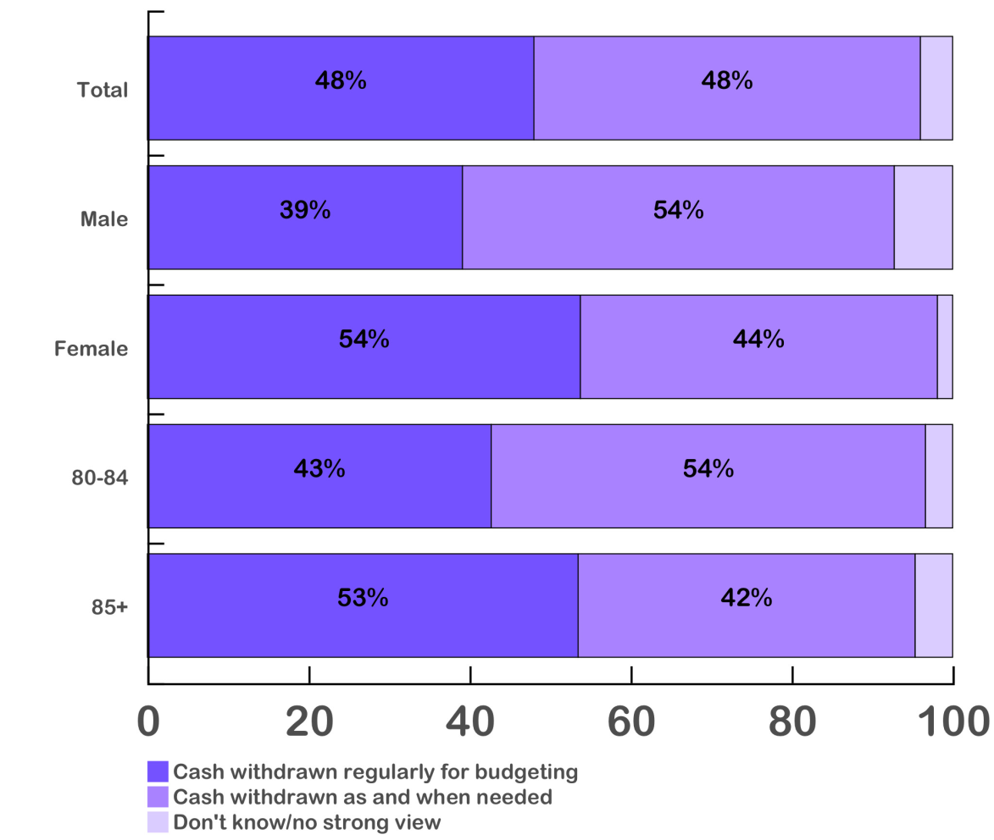
...Cash is used as the main way of budgeting and keeping track of money for around half of those responding. Nearly two-thirds saw no need to use credit cards or were positively opposed to them....

Slide 15
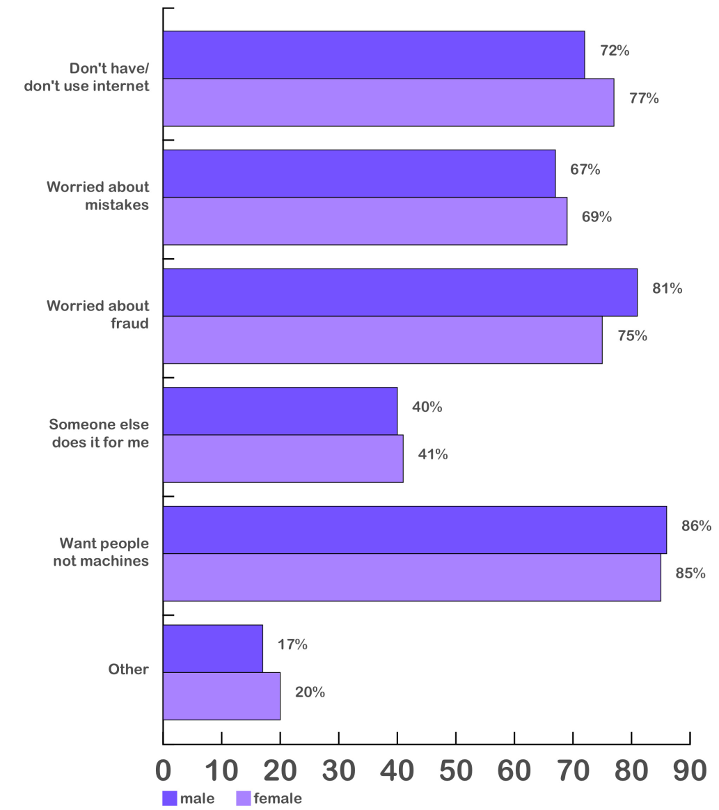
...87% never use the internet for financial transactions. Those who do are more often shopping – only 9% are banking online. Reasons for non-use include not having the internet and worries over fraud, making mistakes and an overriding preference for interacting with people...

Slide 16
...More than a third either never use an ATM or avoid them as much as possible. The majority of those using ATMs only do so inside a bank/Post Office, with only one in five prepared to use them in the street...
 | Total |  |  | Male | Female |  |  | 80-84 | 85+
Anywhere, including in street | 19% |  |  | 26% | 15% |  |  | 25% | 14%
Only inside a building | 12% |  |  | 14% | 10% |  |  | 15% | 9%
Only inside bank/Post Office | 34% |  |  | 39% | 30% |  |  | 37% | 30%
Avoid if possible | 14% |  |  | 10% | 17% |  |  | 11% | 17%
Have never used ATM | 21% |  |  | 10% | 27% |  |  | 12% | 29%

Slide 17
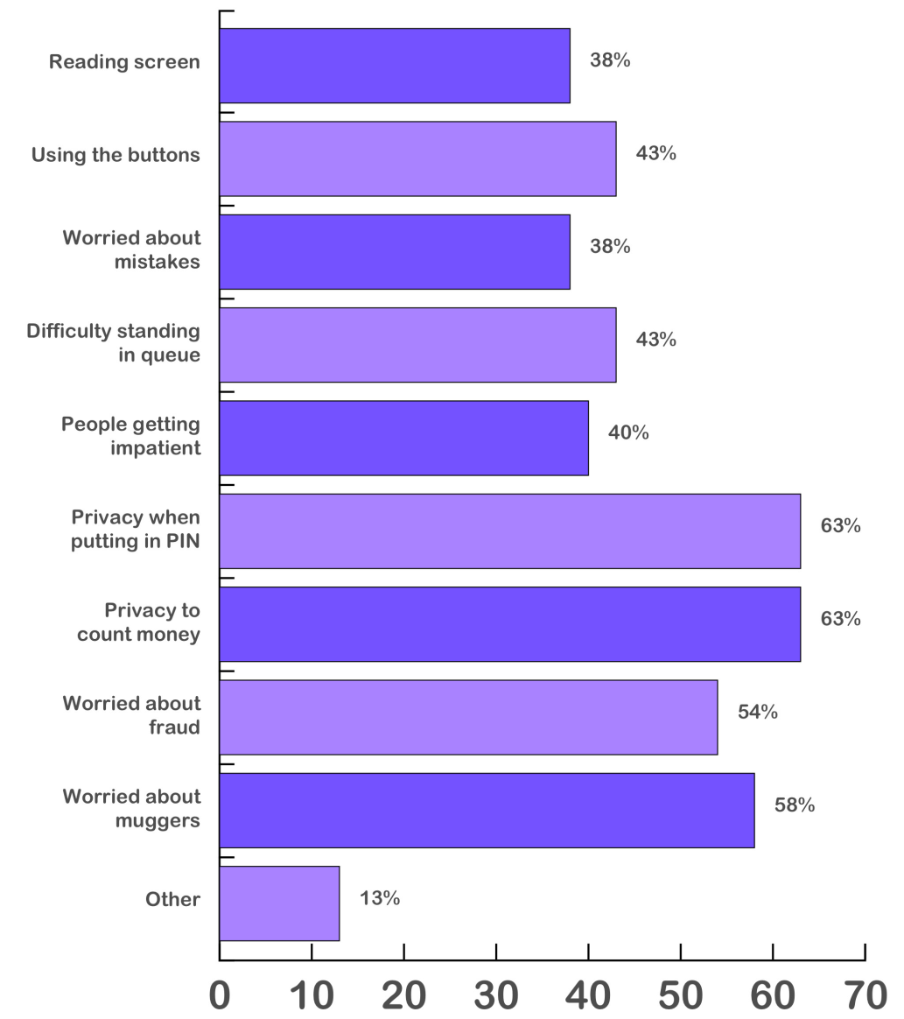
...Concerns about ATMs range from worries about privacy, fraud or theft, to physical capacity issues (stiff fingers, poor sight) and anxiety about making mistakes or being pressurised to be too quick...

Slide 18
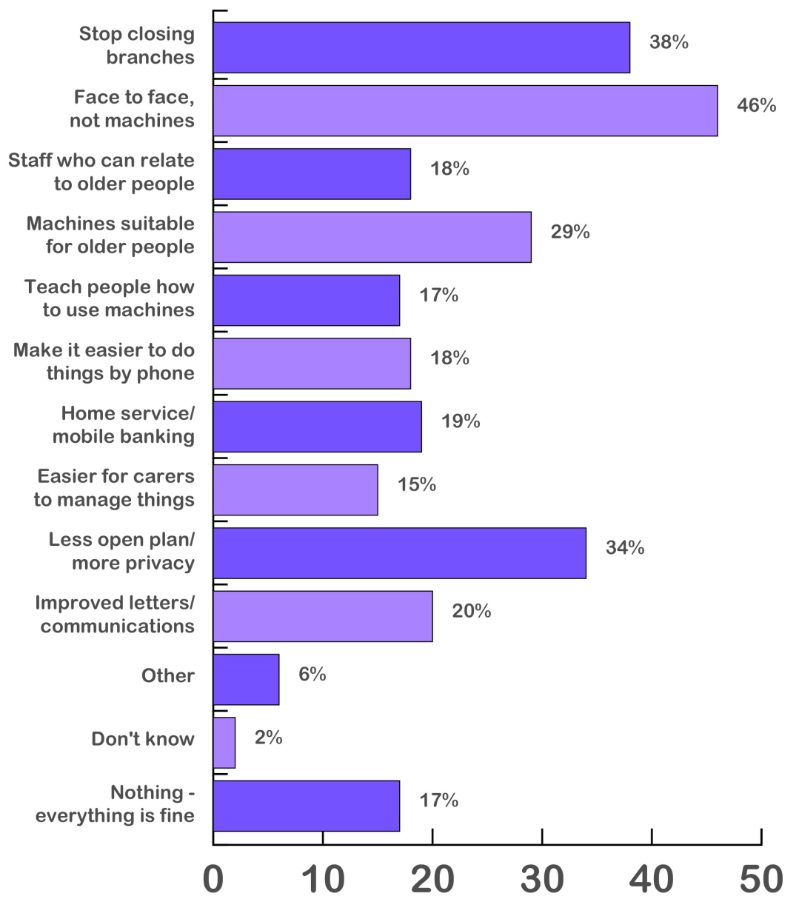
...Older people are concerned about branch closures, about privacy when getting out money and about their access to face-to-face support, all reflected in the changes they say they would like to see...

Slide 19
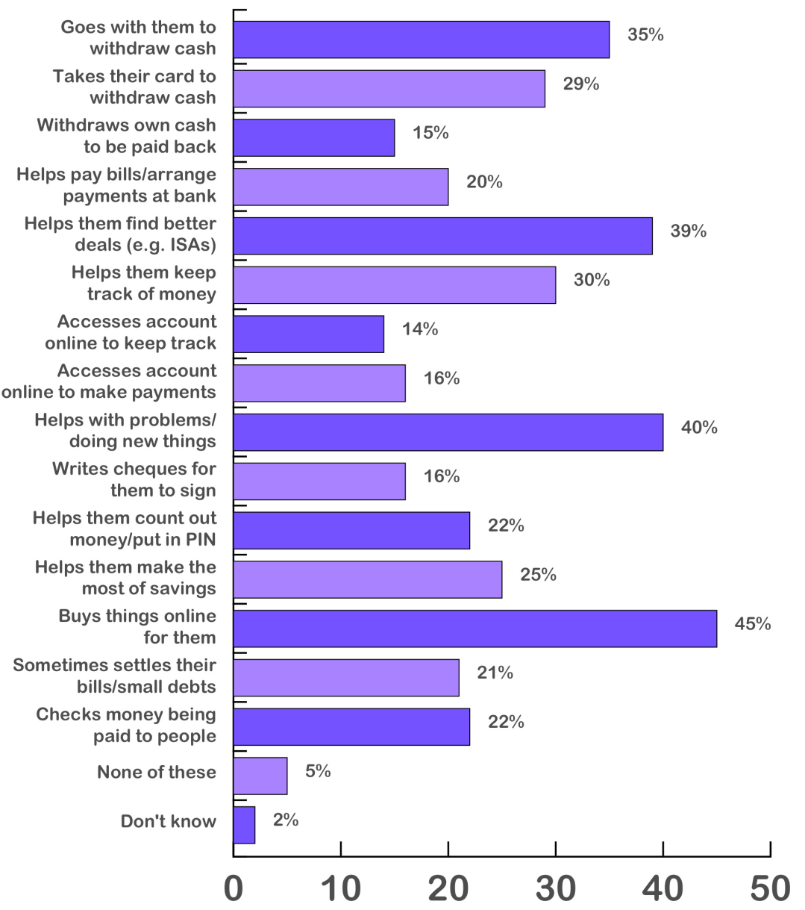
...Carers get involved as older people get less physically capable (53%), more confused/anxious (24%) or experience bereavement (31%). Their support ranges from the routine to the much more heavily hands-on...

Slide 20
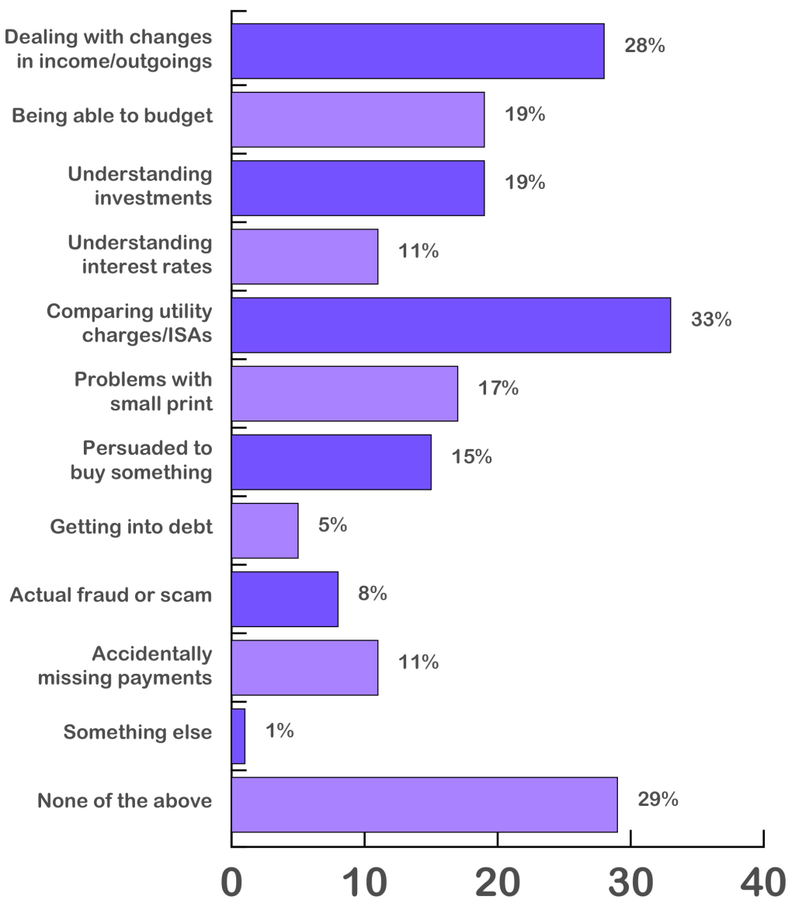
...Carers report a wide range of tasks that older people struggle with, from understanding changes in their income/outgoings to comparing tariffs/interest rates to more serious issues of fraud...

Slide 21
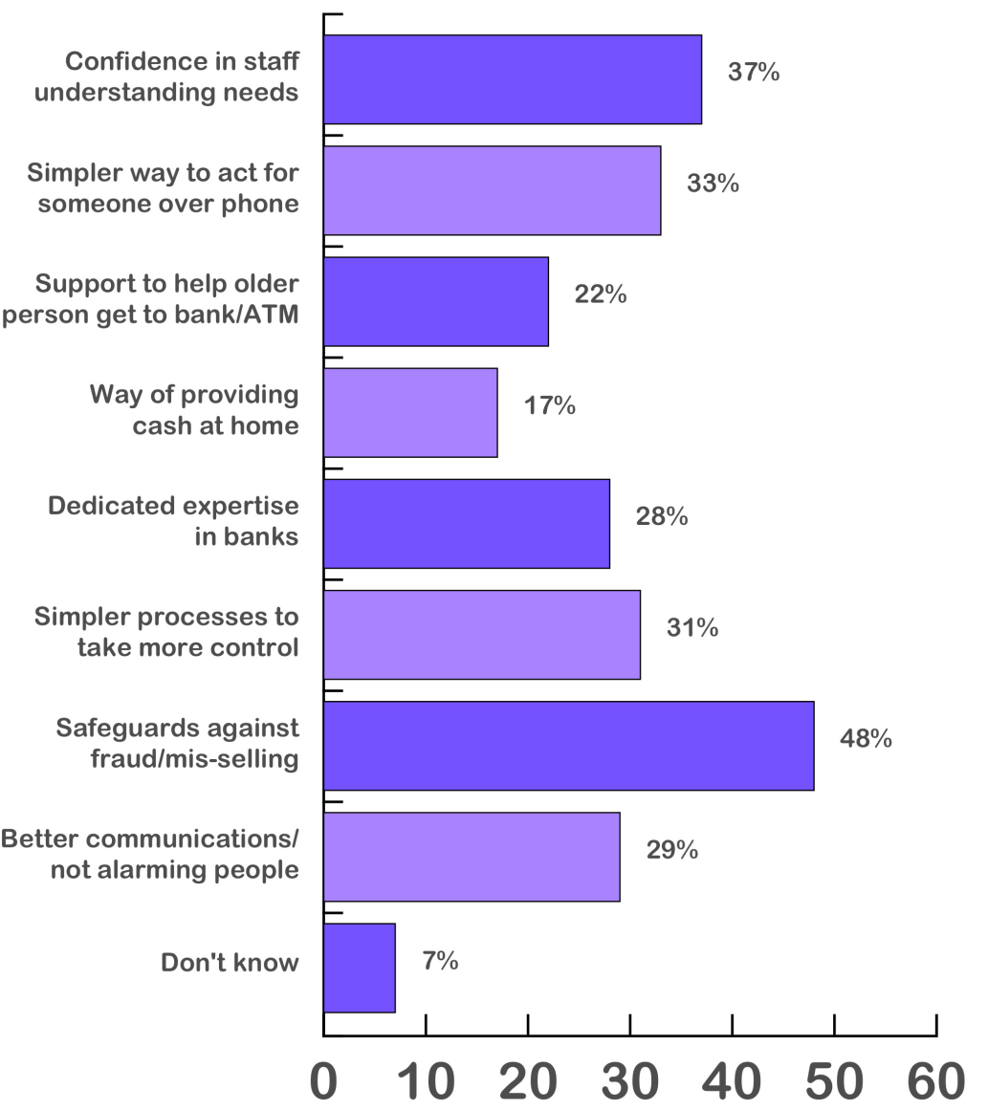
...Carers want better support and expert advice from banks in managing their role and in understanding how to take greater control as well as reassurance that older people are being protected from fraud, scams and mis-selling...

Slide 22
Why is all this becoming such a problem?

Slide 23
...Rapid technological change has transformed how most of us carry out financial transactions – internet and smart phone banking and the explosion in online shopping is driving a shift to electronic transactions. Payments UK expect non-cash payments to exceed those in cash for the first time in 2016...
Consumer Payments: Average per adult per year (Payments UK)
 | 2014 | 2024 | % change
Cash | 345 | 225 | -35%
Cheque | 7 | 2 | -71%
Debit card | 172 | 282 | +64%
Credit card | 41 | 53 | +29%
Automated credit (incl. standing orders) | 20 | 37 | +85%
Direct debit | 63 | 67 | +6%
Other (store cards, PayPal, Prepayment cards) | 9 | 12 | +33%
TOTAL | 657 | 678 | +3%

Slide 24
More bank branch and building society closures will follow
Cash will be dispensed via ATMs, the fall in cheque use (and roll-out of cheque imaging), plus the growth in online and smartphone banking means far fewer bank deposits will be made, while most automated payments will be set up online or over the phone, not in a branch
Banks will continue to close expensive high street premises as footfall continues to decline – in 2016 branches had an average of 71 visits per day (down 30% since 2011). This is expected to fall to 51 per day by 2021.
Over half of all UK bank branches have been lost in the last 25 years and this trend will continue.

Slide 25
Demographic change will lead to big increases in the population aged 80+
The number of people aged 80+ will rise from the current level of 3 million to 5 million by 2030, of whom 1 million will be over 90.
While one in every 21 people was aged 80 or over in 2014, this will increase to 1 in 14 by 2030 and 1 in 12 by 2039.
People will also have more years living with a limiting illness or disability – current estimates are that men will have around 8 and women around 10 years.
The number of health conditions older people need to manage increases with age: at age 80-84 two condition is most common, by 90-94 it is five.

Slide 26
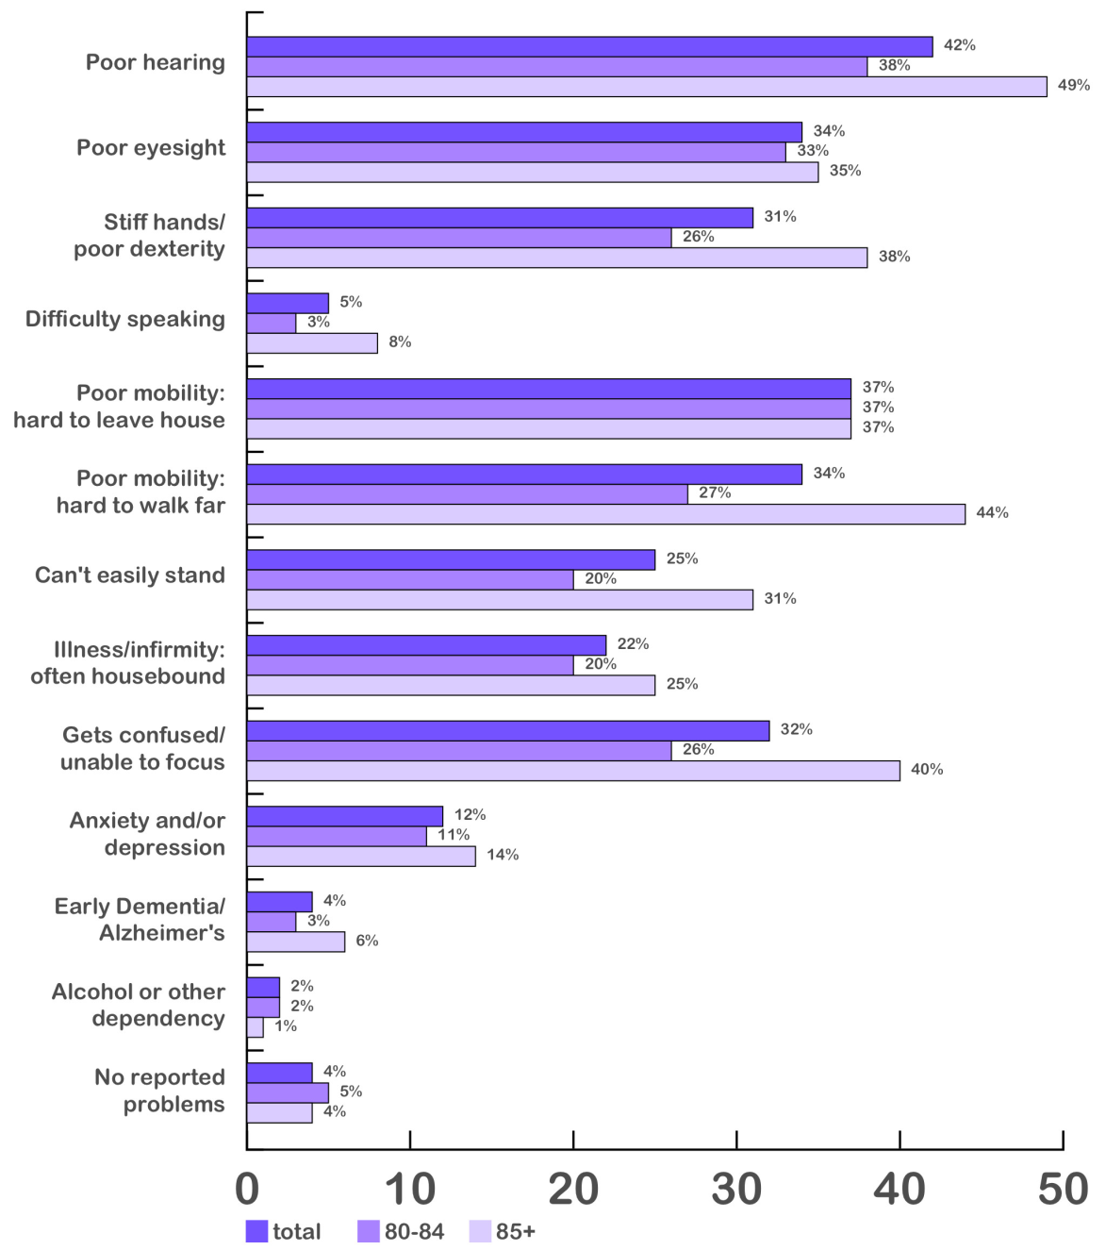
Health issues affecting older people with carer support

Slide 27
What does this mean for financial exclusion – the inability, difficulty or reluctance to access mainstream financial services?

Slide 28
Factors driving financial exclusion
The Older Population
Digital exclusion – only 9% bank online, smartphone banking minimal and overall use of internet is low
High reliance on cash for small payments or for re-imbursing those doing work or shopping for them, as well as using cash as a key budgeting tool
High valuation of face-to-face contact – want to deal with people not machines
Fear of theft, fraud and scams – online and at ATMs
Physical and cognitive barriers to use of technology

Slide 29
Factors driving financial exclusion
Wider Social Trends
Change from physical to virtual banking:
“Do you know what our busiest bank branch is in the UK? It’s our mobile app on the 7.15am train to Paddington.” Chief executive of major British bank.
More people living longer, and with longer periods of disability/incapacity
High valuation on continuing to live independently – 59% of those aged 85 or more live alone; just 16% live in residential or nursing homes
Reduction in social care support will lead to increased reliance on family and other informal carers where this is available

Slide 30
‘They always say the old people are going to die and it won’t be a problem, but there’s always new ones coming up’
Age UK (2011) The Way We Pay: Payment Systems and Financial Inclusion.

Slide 31
Is this a cohort issue or an age issue?
Will future generations of the older old – the ‘new ones coming up’ – have skills acquired earlier in life in internet and mobile banking and a lifelong familiarity with ATMs, contactless and cashback that mean their experience of older age will be different?
or
Are there issues that mean their needs from the banking sector in carrying out day-to-day financial transactions will always differ from the needs of younger age groups due to the nature of the ageing process itself?

Slide 32
Cohort Effect
Take-up of technology higher in younger old
Ofcom data show that 11% of those aged 75+ use internet banking, with this rising to one-third of 65-74 year olds and nearly half of 55-64 year olds
In our study 53% of people aged 85+ were prepared to use ATMs, rising to 77% of 80-84 year olds
With rates of use of technology increasing all the time, clearly new cohorts of much older people will have much greater familiarity with tools for remote or virtual banking

Slide 33
Evolution not revolution
The pace of change is slow
One million people will be over the age of 90 in 2030 and they are already at least 75
Ofcom data show that only 3% of those aged 75+ who don’t have the internet intend to change
  Age UK’s forward projections of internet use led them to conclude that,
  ‘achieving the goal of getting the vast majority of the population online is unlikely to happen in the first half of the 21st Century’

Slide 34
Age Effect
Other factors may counteract cohort effect
Cognitive change/Dementia: Even those who are adept at using technology in their 50s and 60s may at a certain point become less capable of these sorts of tasks, more likely to make mistakes or be more anxious about it
Vulnerability to scams and fraud, partly due to cognitive change or inexperience, but also because old are deliberately targeted – may expose them to greater risk using online/phone than traditional methods based on cash
Sensory and physical barriers – macular degeneration, loss of mobility/arthritis etc. may mean using self-operated technology becomes too much of a challenge
Social contact highly valued and important for well-being – older people likely to continue to want to shop and bank face-to-face even though they have technology to do otherwise

Slide 35
Conclusion
  Our report concludes, therefore, that,
  ‘the confluence of radical change in the banking infrastructure with longer periods of multiple health-related disability at the end of people’s lives, combined with older people’s inclination to seek straightforward, safe and familiar ways of doing things and to maintain social, ‘non-machine’ forms of contact, risks creating a significant tranche of people in the very oldest age groups who will, unless new solutions are found, become financially excluded as they age.’
  The Finance Foundation (2016) “When I’m 84”. Locking the Door on the Older Old: the Challenge Facing Britain’s Banks, p.62.

Slide 36
What could be done to mitigate this risk?

Slide 37
Changes that would support older people
Re-modelling and re-design of technology and practice to be age-inclusive
Securing a physical infrastructure to support continuing access to services
Building a stronger partnership between the industry, older people and their carers
Embedding age-proofing within government and the industry, and changing regulatory focus

Slide 38
What is the policy response required?
Legal and regulatory framework
Age proofing and champions for financial inclusion
Issues around age discrimination exemption for financial services
What role might FCA take in supporting inclusive services?
Age-appropriate design and practice
Incentivise age-friendly design of products, services and technology
Government and industry to work to develop new ideas, provide safe spaces to innovate and leverage intelligent technology to support older people in their home – e.g. voice activated screens
Older people’s needs for adapted spaces to be designed in from the start as new physical infrastructure is planned
Training for staff with public facing role in interacting effectively

Slide 39
What is the policy response required?
Maintaining a viable physical infrastructure
Commitment to long-term funding of a national physical infrastructure providing face-to-face service for all customers who require it, to replace loss of bank branches – Post Office, shared branches or similar
Innovative ways to provide services at home, including cash delivery by post or with home deliveries, or home visits for specific purposes
New solutions for those with mobility challenges or in isolated communities – e.g. pop up banking services in existing day facilities used by older people, with transport provided as necessary. Funded on a preventative rationale.
Provision for delegation and support to families
Better provision for limited delegation without loss of control
Better signposting for relatives and streamlined processes for taking control when that becomes necessary
Better protection when abuse, fraud or declining capabilities are leading to significant risk or detriment

Slide 40
Thank you!
THE END

Slide 43
Understanding and planning for future needs
All data collection and research on older people, including for official data, should in the future include a separate category for those aged 80 and over, ending the existing practice of lumping everyone over retirement age into a single category of “older people” despite the very different needs of the rapidly growing demographic of older old.
Research on the next generation of the older old – which might usefully focus on the large numbers of post-Second World War baby boomers now entering their 70s – should look at how they manage technology as they enter their 80s and 90s, including how they cope with developing physical and cognitive challenges, in order to identify what the main challenges of ageing are for those who experienced the internet revolution in their mature years, and how this might impact on their ability to remain financially included in a digital and increasingly cashless world.

