Slide 1
Mental health of aged people in Bulgaria during the Covid-19 pandemics
Marta Sugareva
Professor of Statistics and Demography
Plovdiv University “Paisii Hilendarski”
Bulgaria

Slide 2
Introduction
The two last years with Covid-19 have been a painful period for people all aver the world.
Never before we had seen pictures of the main streets of beautiful cities like Paris deserted from their inhabitants. People were told to stay at home, because a dangerous virus was attacking. We should not meet with each other – except with the members of the household. (Consequently, those who were living alone should not meet with anybody?)
A National Operative Headquarters (НОЩ, Bulgarian abbreviation of NOH) was nominated by the prime minister Boiko Borissov, whose head Major General Prof. D-r V. Mutafchiiski soon became the most popular person in the country.
This institution was presenting every morning a detailed report on the national TV about the progressing of the disease – how many people have contracted it (sick), how many went to hospital, including to intensive care, to intubation, how many died, etc.
These regular official information, as well as many of the other information provided by the mass media, created a mass fear.

Slide 3
Fear and Mental disorders

Slide 4
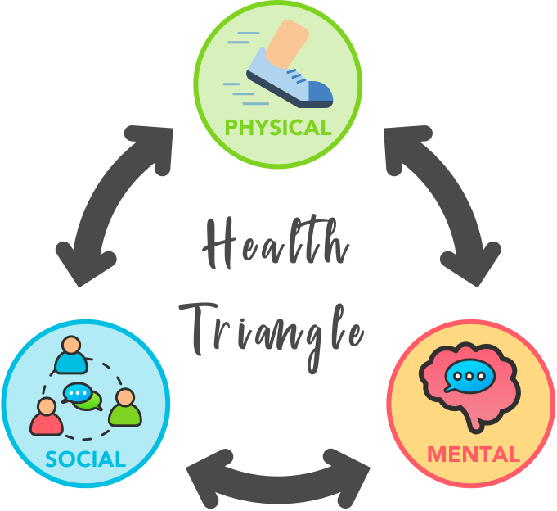
The “Health Triangle”: Dimensions of health
Physical dimension:
ability to resist disease
ability to recover from illness and injury
sufficient energy, strength and coordination to engage in daily physical activity
appropriate weight and nutrition
Social dimension:
development and maintenance of social interactions and relationships
positive and effective communication
cultivation of social skills
positive contribution to the community
accessing support services when needed
Mental dimension:
ability to understand and express emotions
self confidence and positive self esteem
ability to cope with challenging situations and to deal with stress
ability to solve problems
capacity to love, work and play https://slideplayer.com/slide/8710652/

Slide 5
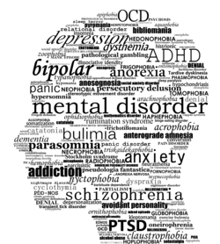
Mental health and Mental disorders (psychique troubles, mental problems)
According to the World Health Organization, Mental health is "a state of well-being in which the individual realizes his or her own abilities, can cope with the normal stresses of life, can work productively and fruitfully, and is able to make a contribution to his or her community“.
Mental disorders:
mood disorders (such as depression or bipolar disorder)
anxiety disorders.
personality disorders.
psychotic disorders (such as schizophrenia)
eating disorders.
trauma-related disorders (such as post-traumatic stress disorder)
substance abuse disorders.

Slide 6
Another classification of mental disorders
Depression (sadness, loss of interest or pleasure, feelings of guilt or low self-worth, disturbed sleep or appetite, tiredness, and poor concentration)
Bipolar disorder (both manic and depressive episodes separated by periods of normal mood. Manic episodes involve elevated or irritable mood, over-activity, rapid speech, inflated self-esteem and a decreased need for sleep. People who have manic attacks but do not experience depressive episodes are also classified as having bipolar disorder)
Schizophrenia and other psychoses (distortions in thinking, perception, emotions, language, sense of self and behavior). Common psychotic experiences include hallucinations (hearing, seeing or feeling things that are not there) and delusions (fixed false beliefs or suspicions that are firmly held even when there is evidence to the contrary)
Dementia (deterioration in cognitive function (i.e. the ability to process thought) beyond what might be expected from normal ageing. It affects memory, thinking, orientation, comprehension, calculation, learning capacity, language, and judgement)
Developmental disorders including autism.
(https://www.who.int/news-room/fact-sheets/detail/mental-disorders)

Slide 7
Mental Problems (poor mental health) and Mental illness (disorders) are not the same.

Slide 8
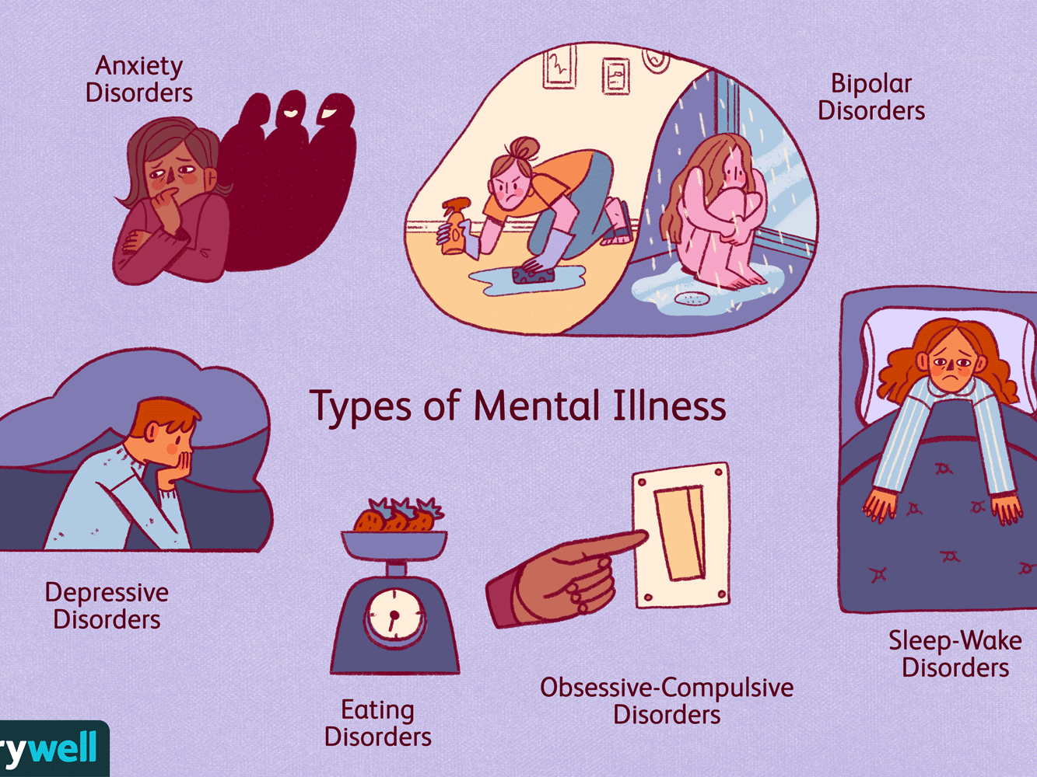

Slide 9
The most common types of mental illness:
Anxiety disorders
Depressive disorders
Substance use disorder (SUD)
In Europe 25 million people (or 5.4% of the population) are estimated to be living with anxiety disorders, followed by depressive disorders, which affect over 21 million people (or 4.5% of the population).
SUD often is occuring in comorbidity with other mental disorders.
(European Monitoring Center for Drugs and Drug Aiction. Comorbidity of substance use and mental health disorders. LISBON MAY 2016. Online.)

Slide 10
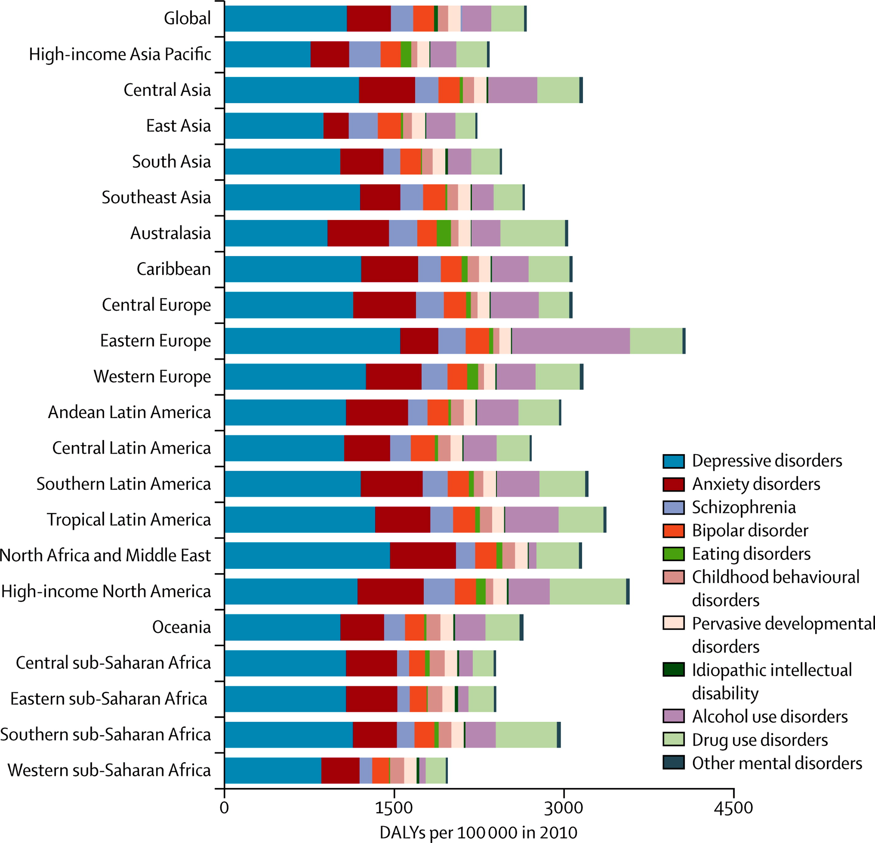
Eastern Europe is most affected. Global burden of disease attributable to mental and substance use disorders: findings from the Global Burden of Disease Study 2010 (The Lancet Journal)
DALIs = disability-adjusted life years

Slide 11
“DALY” (the measure from the previous slide) - meaning
DALI = disability-adjusted life year
The overall burden of disease is assessed using the disability-adjusted life year (DALY), a time-based measure that combines years of life lost due to premature mortality (YLLs) and years of life lost due to time lived in states of less than full health, or years of healthy life lost due to disability (YLDs).

Slide 12
Eurostat: 7.2% of people in the EU suffer from chronic depression. Bulgaria has a low level of reported chronic depression: about 2.5% of the population.)
European health interview survey (EHIS), 2019

Slide 13
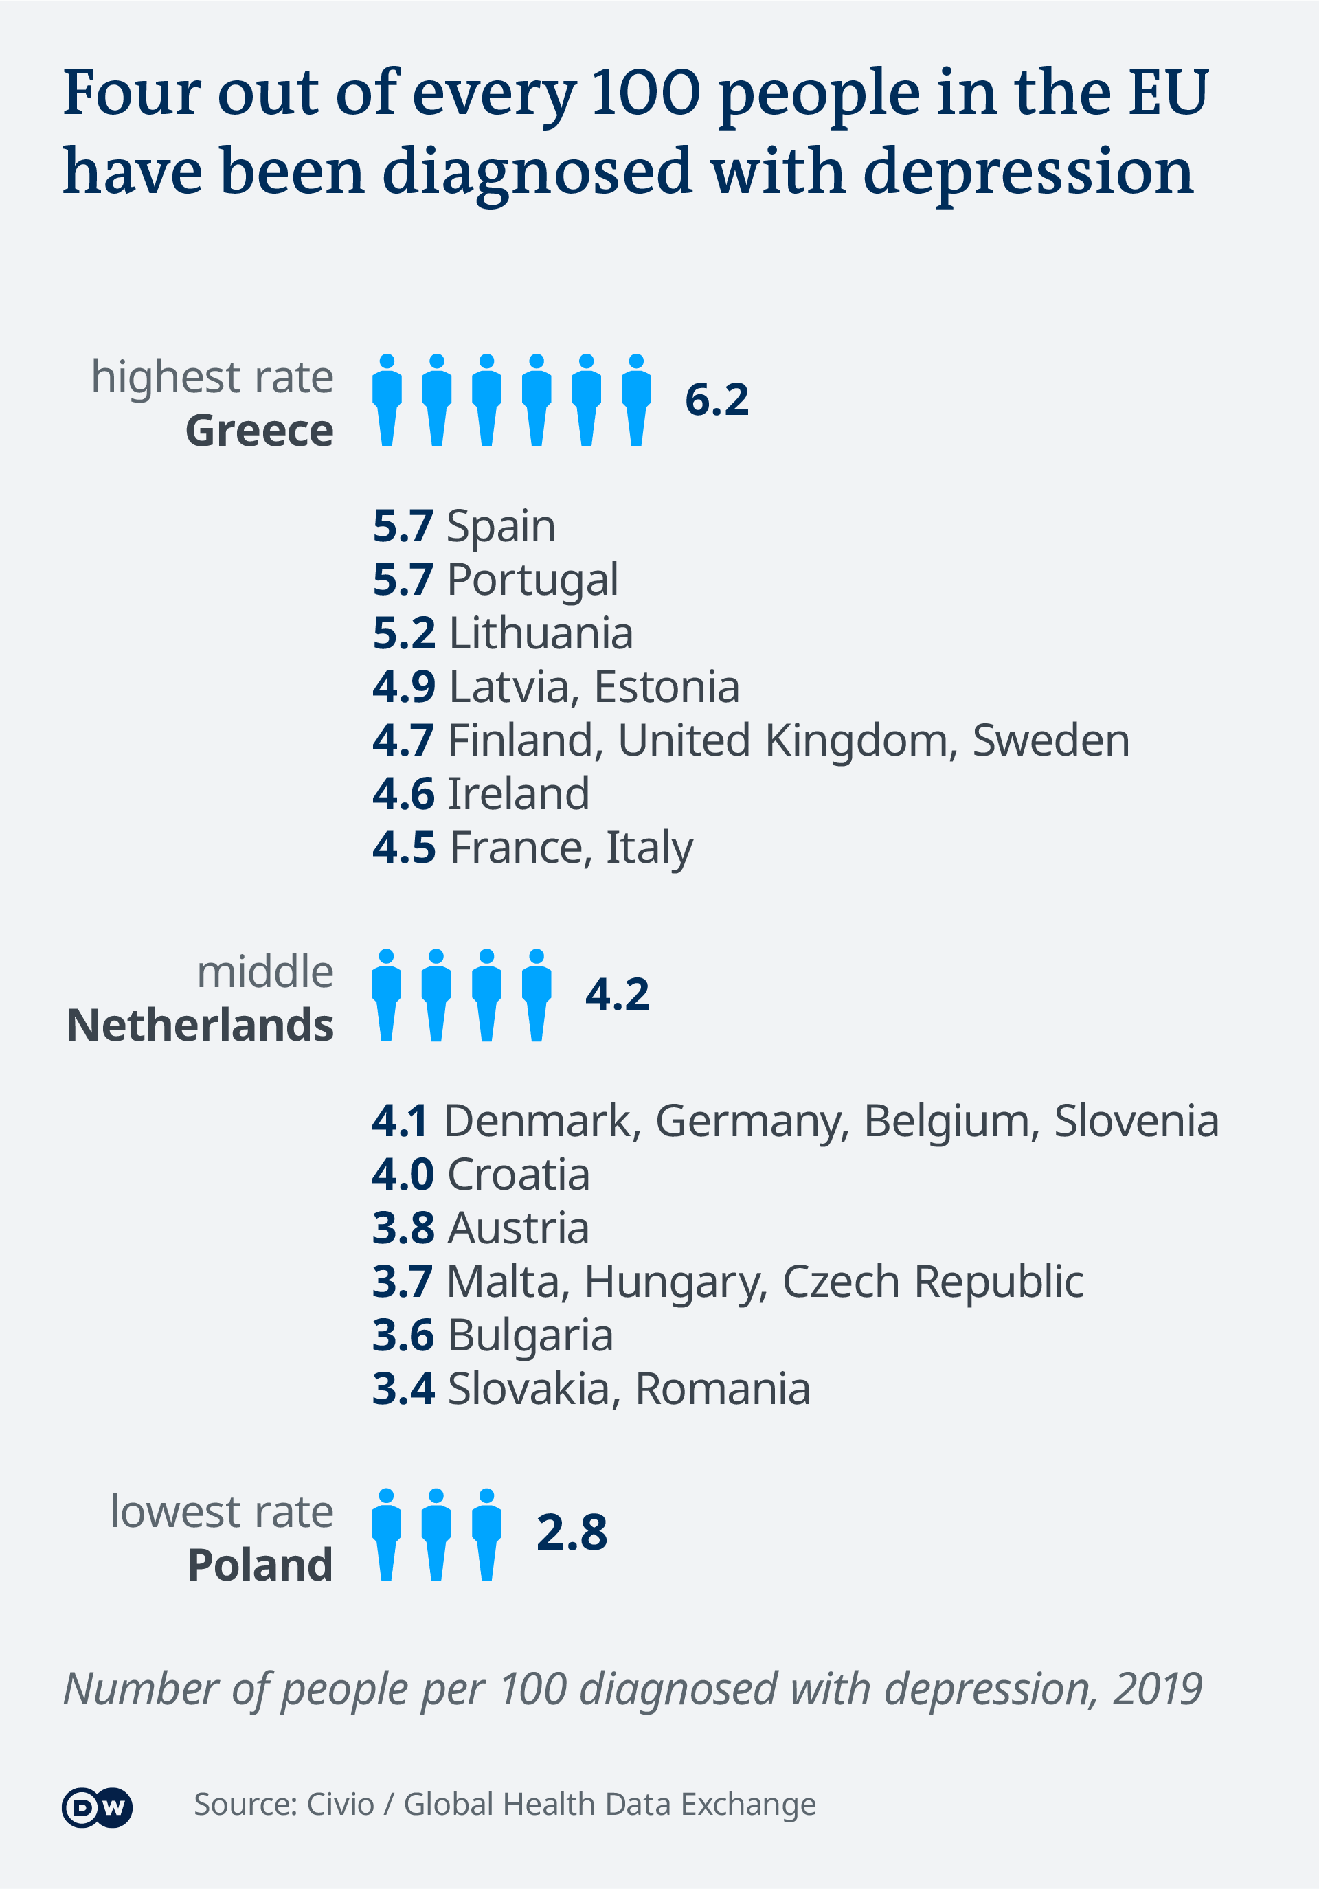
Bulgaria (3.6%) is in the middle group - slightly below the EU middle of 4.2%.
https://www.dw.com/en/pay-up-or-put-it-off-europe-fails-to-treat-mental-health/a-56812344

Slide 14
Cost of mental health in EU countries

Slide 15
https://www.dw.com/en/pay-up-or-put-it-off-europe-fails-to-treat-mental-health/a-56812344
"There are three main problems: stigma, waiting times and user fees," said Marcin Rodzinka, a spokesperson for NGO Mental Health Europe, which advises EU organizations on policy. The 2017 European Commission report backs this up.
"There is a lot of shame and fear associated with the idea of going to a psychiatrist," said Maria, who visits a psychotherapist in Romania and asked not to reveal her real name. "No one talks about it openly, so no one knows what to expect from an appointment with the psychiatrist. No one wants to be labeled as crazy."

Slide 16
Old age is a prerequisite for worsening health status
At the biological level, ageing results from the impact of the accumulation of a wide variety of molecular and cellular damage over time. This leads to a gradual decrease in physical and mental capacity, a growing risk of disease and ultimately death. These changes are neither linear nor consistent, and they are only loosely associated with a person’s age in years. The diversity seen in older age is not random. Beyond biological changes, ageing is often associated with other life transitions such as retirement, relocation to more appropriate housing and the death of friends and partners.
(https://www.who.int/news-room/fact-sheets/detail/ageing-and-health)

Slide 17
The impact of the Covid-19 pandemic on mental health

Slide 18
We believe that a great part of mental disorders in Bulgaria are not diagnosed, especially in old age
There is a social stigma on mental disorders.
The health care system is lacking specialists and proper financing, especially what concerns the mental health diseases. They are underestimated, and often discriminated.
Old people usually lack financial resources as to prevent mental health problems.

Slide 19
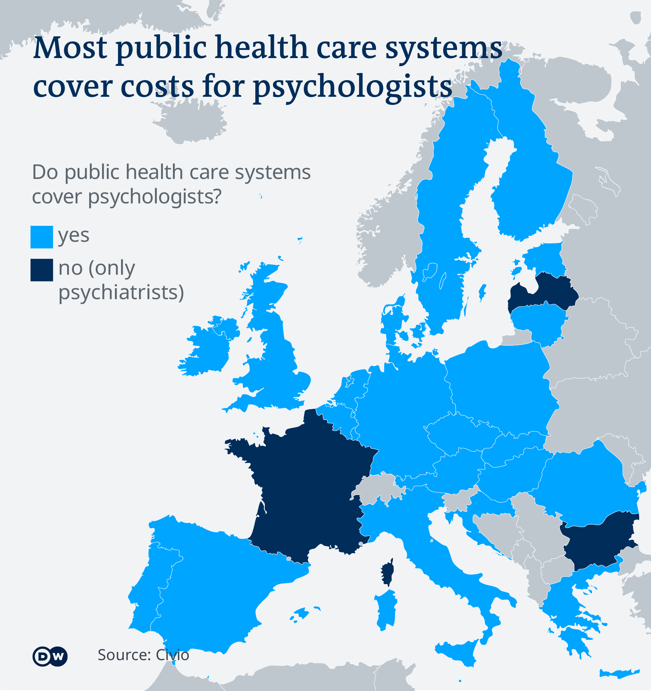
BUT NOT IN BULGARIA.
https://www.dw.com/en/pay-up-or-put-it-off-europe-fails-to-treat-mental-health/a-56812344 - 10.03.2021

Slide 20
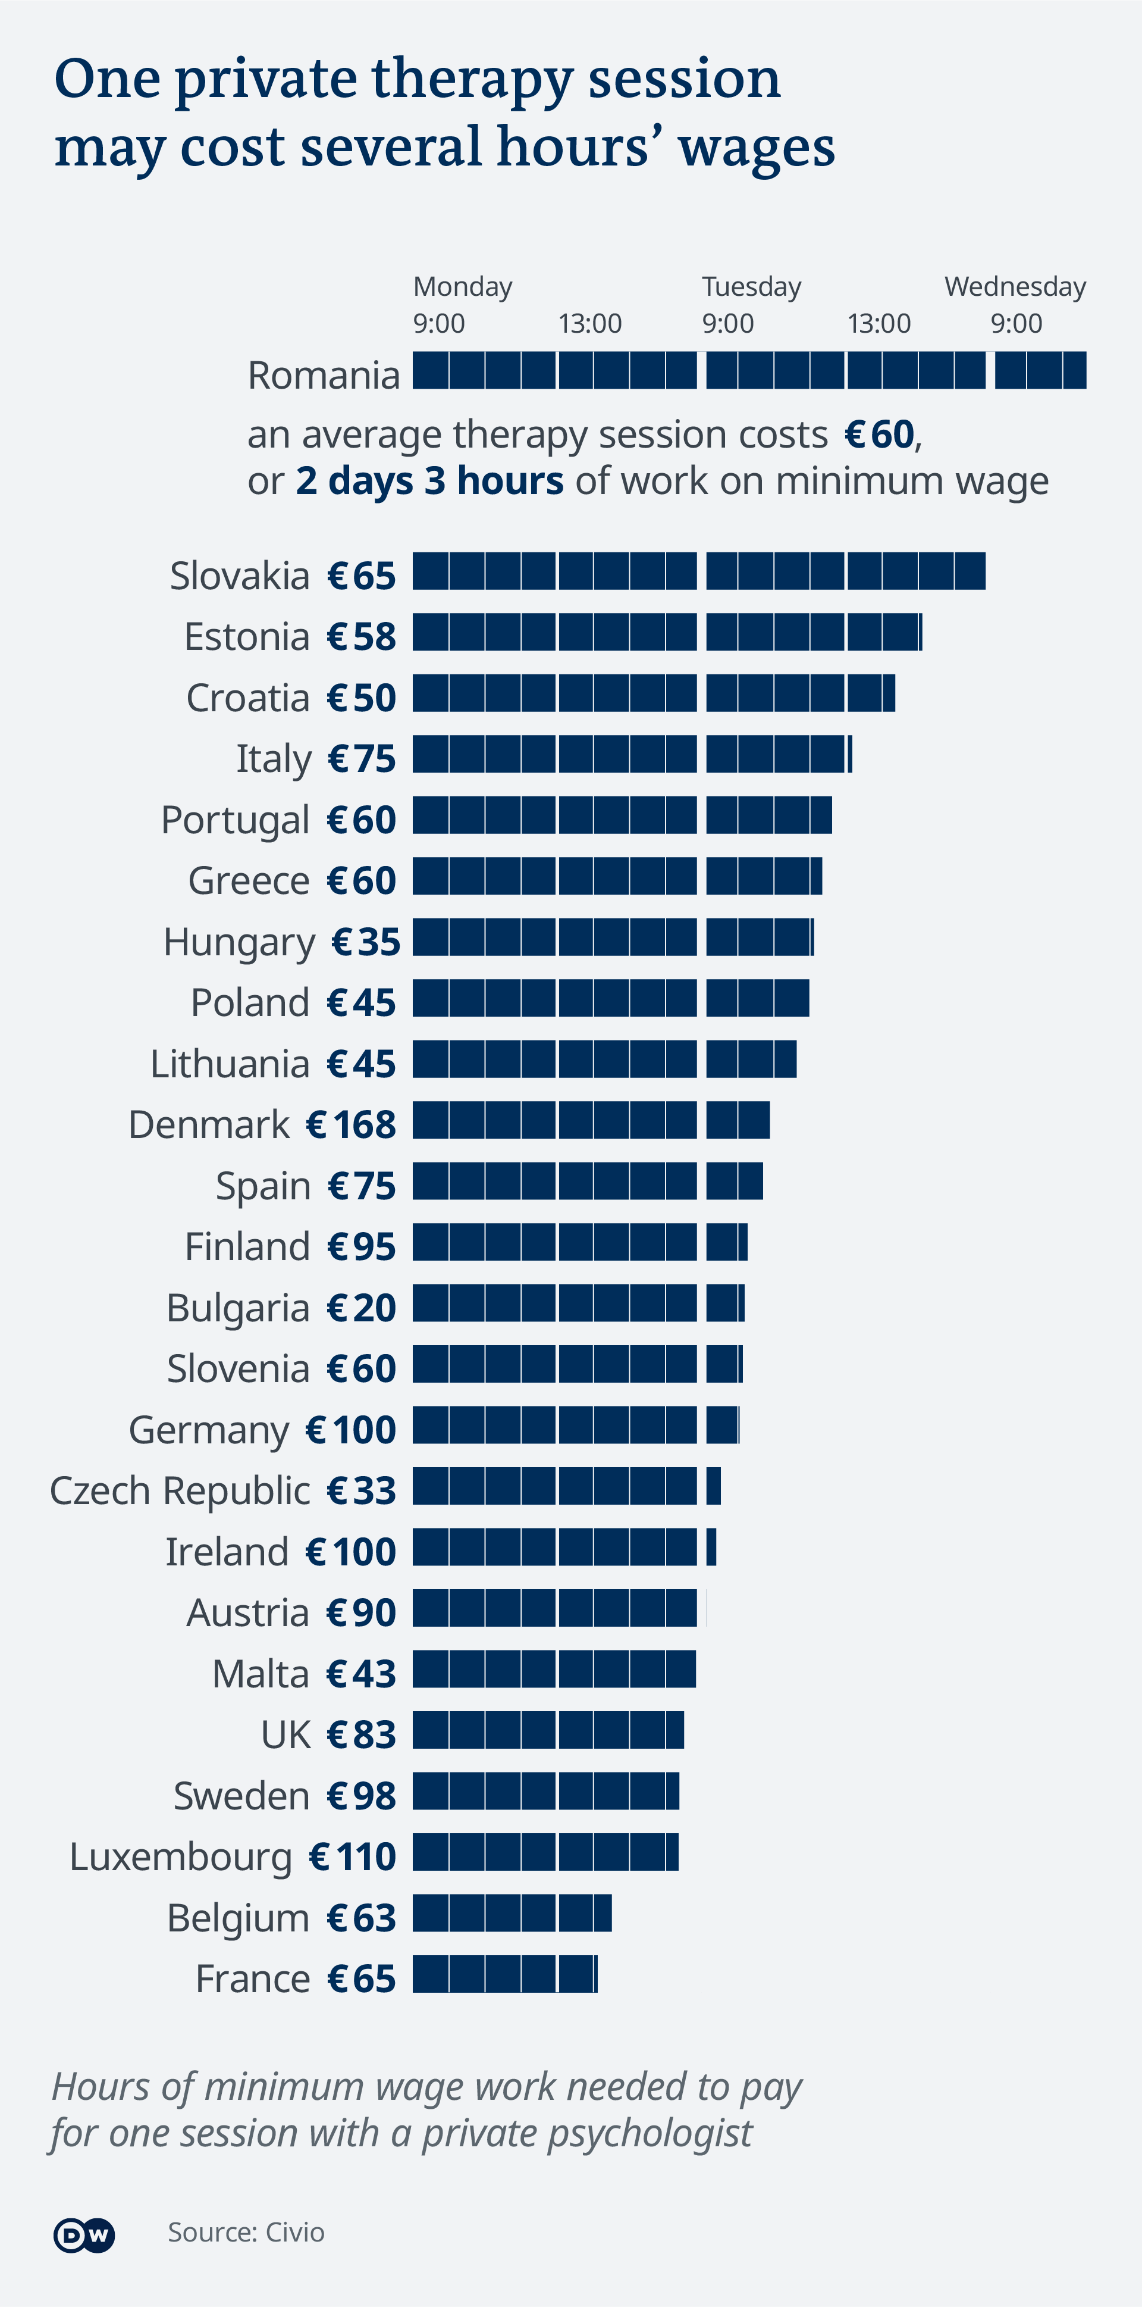
https://www.dw.com/en/pay-up-or-put-it-off-europe-fails-to-treat-mental-health/a-56812344

Slide 21
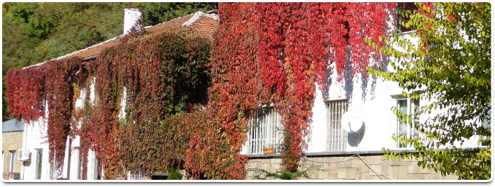
In Bulgaria
The usual price for a psychologist consultation is 40-50 leva (for one hour), while (private) psychiatric consultations are even more expensive.
There is a severe demand for psychological and psychiatric help in the country. The National Health Insurance Fund does not cover the psychiatric or psychological consultations. (Except in psychiatric hospitals.) Therefore only rich people can afford to visit such specialists.
The few psychiatric hospitals suffer from poor material conditions, and from a lack of qualified staff.
The State Psychiatric Hospital St. Ivan Rilski in Novi Iskar

Slide 22
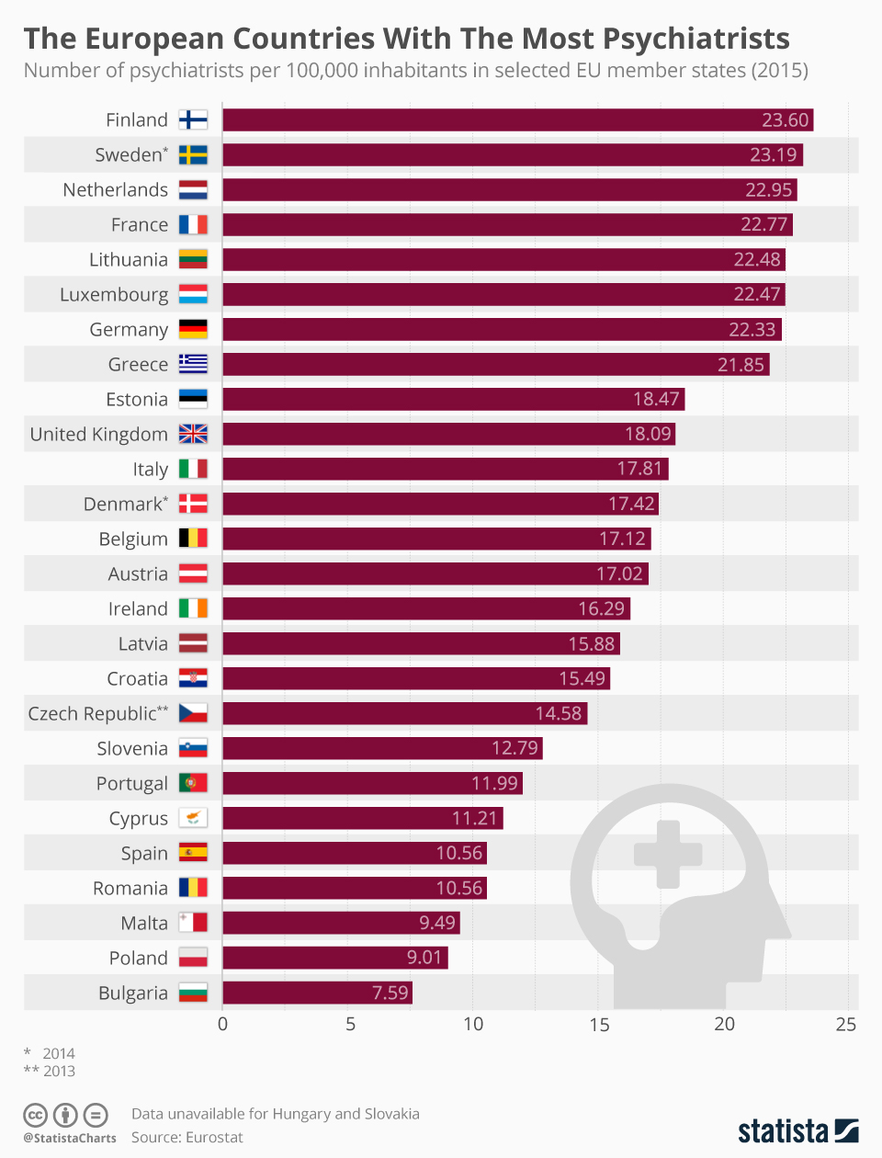

Slide 23
The European Parliament has issued in 2009 a Report about the psychic health. https://www.europarl.europa.eu/doceo/document/A-6-2009-0034_BG.html
There are special directives in it for the mental health of the elderly:
39. Calls on the Member States to take appropriate measures to improve and stabilize the high quality of life for older people, to promote healthy aging and activity through participation in social life, including the development of flexible retirement schemes;
40. Stresses the need to promote research into the prevention and care of degenerative disorders of the nervous system and other age-related mental illnesses, and with regard to future Commission action or proposals, insists on the need to distinguish between Alzheimer's disease and related degenerative disorders; the nervous system from other forms of mental illness;
43. Asks the Commission and the Member States to take measures to support carers and to develop, within the framework of the open method of coordination of social protection and integration, guidelines for treatment and long-term care, contributing to the prevention of ill-treatment of the elderly and for their dignified life in an appropriate environment;

Slide 24
The risk of developing certain mental disorders increases with age
and in addition to Alzheimer's disease, there are other common problems such as
depression, stress, psychotic disorders.
In this context, adults should be treated as the main target group for promoting mental well-being.
By caring for the elderly, we protect both their right to dignified and active aging and the cohesion of society.
The rapporteur supports measures to improve the quality of life of older people.
Particular attention should be paid to research on the mechanisms and causes of
degenerative disorders of the nervous system and other age-related mental illnesses,
as well as their prevention and treatment.
The need for comorbidity assessment and training of health staff is also emphasized,
for reasons of added value that an interdisciplinary approach to complex mental health problems can bring.

Slide 25
The report emphasizes the need for high-quality, affordable, efficient and universal
mental health services.
Combating stigma and social exclusion.
45. Emphasizes the crucial role of the media in changing perceptions of mental illness and calls
for the development of European guidelines for the responsible presentation of mental health in the media;
47. Considers that the destigmatisation of mental illness involves the cessation of the use of
invasive and inhumane practices, such as those based on the model of forced surveillance.

Slide 26
The Covid-19 pandemic in Bulgaria

Slide 27
The Covid-19 pandemic started in March 2020. First we were told that we should not cross the national border, later – that we should not go out of home except for the most urgent needs, such as food and medicines.
(Only to supermarket and to pharmacy.)
We were not allowed to walk in the park, and to gather in groups of more than 3 people.
Some of us thought we had to stay at home all the time, and not meet anybody… For how long - we didn’t know…
They said it was a state of emergency, but some of us interpreted it as a martial law.
The bans were stricter on the elderly, at least this was the general feeling.
Special shopping hours were set in the supermarkets for the old people,
which means that in there hours younger people were not allowed in the supermarkets.
This created protests from some busy young people.
On the other hand, some old people realized (wrongly) that they could go shopping only
during those hours (from 8 to 10AM), which was not true, but all these misunderstandings created turmoil.
Certain public sentiments were created against the old people, and
some elements of ageism emerged or were reinforced.
The hospitals started to overload, and it was clear that the old people were the most common patents.
Every day the headline news would announce the number of deaths.
“Stay at home!” was the main message to the old people.

Slide 28
During the period of Covid19 Pandemics
Old people in Bulgaria were supposed to “stay at home” – this was the phrase that the officials addressed to the population in the first days and weeks, and months after March 13, 2020.
I am a representative of the old people in Bulgaria, one of those who did not stay at home. I went for long walks in the city, trying to avoid public transport. (The buses were running empty which was a painful view.) Most of my friends didn’t want to meet with me, because they were afraid of the virus. With some of them we met occasionally, walking in the streets with masks and talking to each other from a distance.
As a matter of fact the mass media did not take care of the psychic consequences from the restrictive policy undertaken by the government. Many old people did not meet their children and grand-children for months, and some thought this would last forever.
The fear of the virus overran the need for social contacts, but this was very harmful for the psychic health. The policy and the medias didn’t provide any information or support in this respect. (Social distancing instead of Physical distancing?)

Slide 29
Social contacts and physical exercises are basic needs for the elderly. Therefore the instructions given to the old people were not appropriate, because they didn’t take into account the specific impact on mental health of this category of the population.
Old people in Bulgaria are a vulnerable group even without the pandemic: many of them live alone, many have financial problems, and they feared from the virus not only because of the risk for their own lives, but also for their family.
As a consequence of the Covid-19 pandemic the old people in Bulgaria became even more vulnerable, fearing any hazards that inevitably occur in the turbulent times of today.

Slide 30
The war in Ukraine
This war is a new challenge for the psychic health of Bulgarians, and namely of the elderly Bulgarians.
There is a stress from the images of huge bombings of apartment buildings in the cities and houses, and people trying to escape bombs hiding in the basements and in the metro for days… Children and old people, some of them sick or disabled… This is happening at a one day driving distance from us.
We see on TV the images of many young women with small children at the borders between Ukraine and Romania, and with Poland and with Slovakia, who have travelled more than 24 hours in cars in terrible traffics jams, in crowded trains, walking with their luggage taken in a hurry… Over 2,5 million until this day (15.03.2022) – which is the greatest emigration flow in Europe since WWII.
We know that these are mainly the young ones (women and children), less often - old women and old men Most of the older people probably couldn’t afford such a journey. So they were left behind…

Slide 31
Bulgarian society has undergone two major social transformations during the last 70-75 years:
After 1944
After 1989
Those who are now the “old people” in Bulgaria, had to adapt twice to two profoundly contradictory systems of social norms and values, economic structures, ways of thinking and behaving in the society.

Slide 32
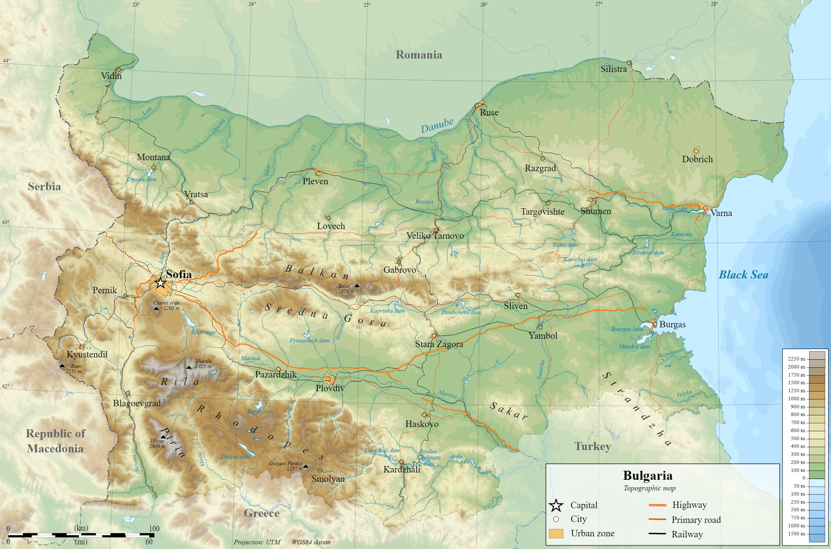
Additional information about the population of Bulgaria

Slide 33
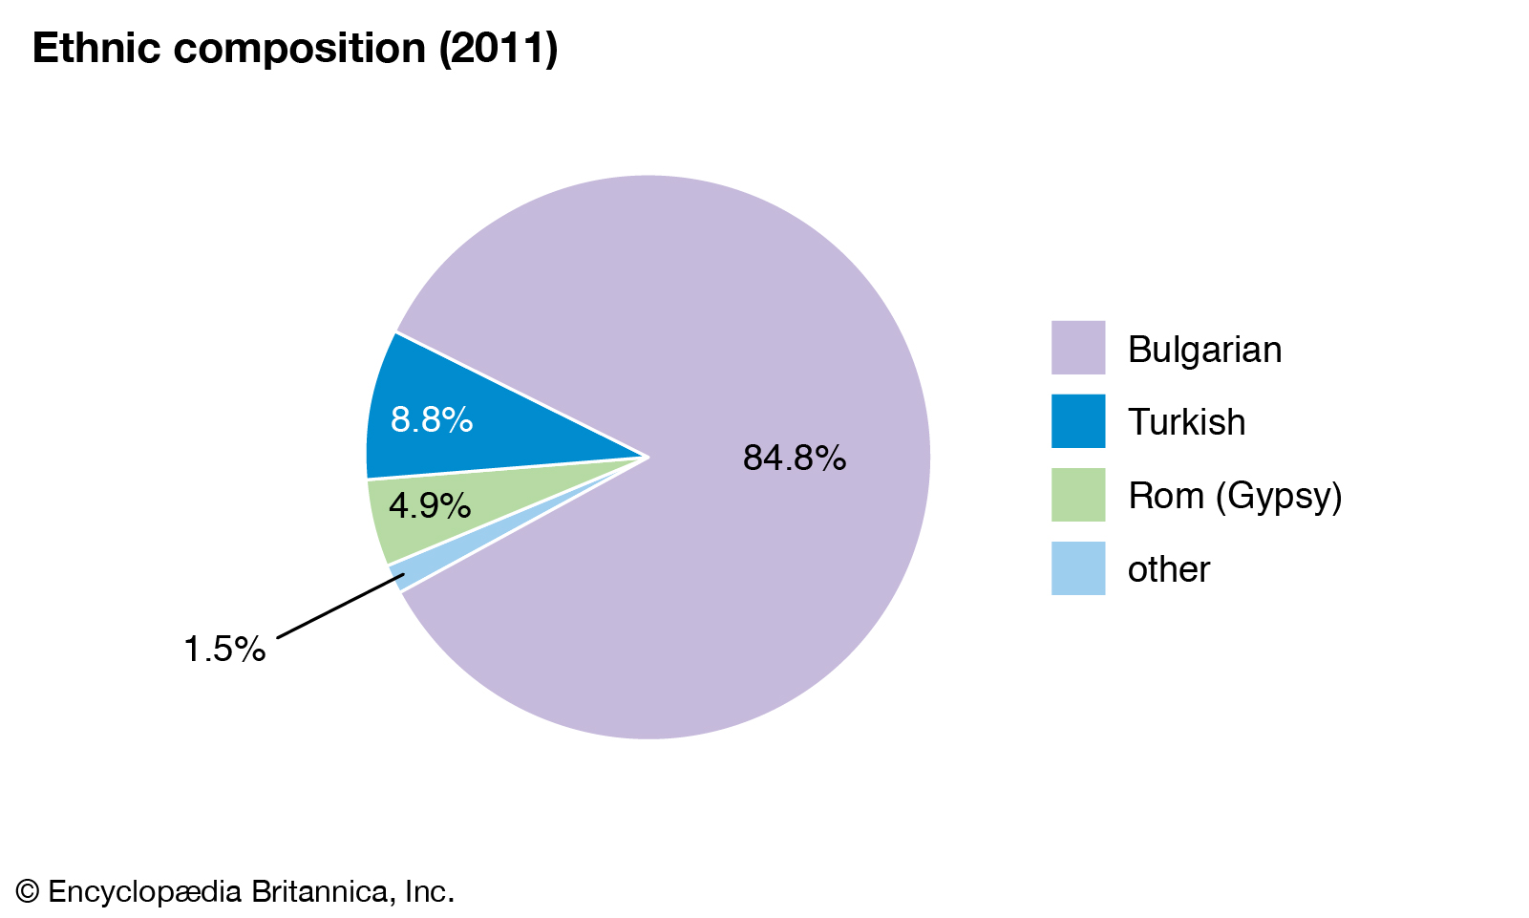
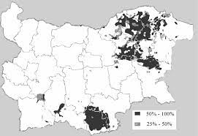

Slide 34
Since 1990 the population is decreasing mainly due to emigration (consisting mainly of young people) Population of Bulgaria from 1880 to 2021

Slide 35
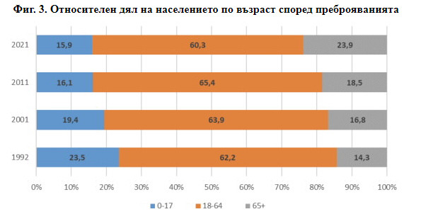
Changes in the age structure of the population between 1992 and 2021. (Percentage of the population of Bulgaria by three age groups:(0-17); (18-64) and (65+)
Bulgaria has one of the oldest populations in Europe: the share of people over 65 is 24% or more. (According to the preliminary data of the 2021 population census.)
A large part of these people live in one or two person households.
Among all households in the country more than 30% are one-person households. The share of one-person households has increased between 2001 and 2011 from 22.7 to 30.8%.

Slide 36
SHARE COVID-19 results on mental health
Keeping Physically and Mentally Fit
Researchers observe a mitigating effect of even moderate physical activity on depression.
Therefore, public health programs designed to improve mental health of older adults in Europe and Israel should include policies promoting physical activities as they not only improve physical fitness but also boost self-esteem and offer an opportunity to socialise.
Study by Adilson Marques, Margarida Gaspar de Matos, Joana Bordado, Élvio R.Gouveia, Miguel Peralta and Diego Gomez-Baya (2020): Different levels of physical activity and depression symptoms among older adults from 18 countries: A population-based study from the Survey of Health, Ageing and Retirement in Europe (SHARE). European Journal of Sport Science, DOI: 10.1080/17461391.2020.1795273
URL: https://doi.org/10.1080/17461391.2020.1795273
Photo: Adobe Stock / DenisProduction.com

Slide 37
Thank you for your attention!

