Slide 1
The Process of Population Ageing and Its Challenges in Asia
Heather Booth
Research School of Social Sciences
Australian National University
ARC Centre of Excellence in Population Ageing Research
Public Lecture, 10 February 2016
The Oxford Institute of Population Ageing

Slide 2
Outline
The process of population ageing
Measuring population ageing
Trends in Asia – exploring heterogeneity
Challenges – social security in old age

Slide 3
THE PROCESS OF POPULATION AGEING

Slide 4
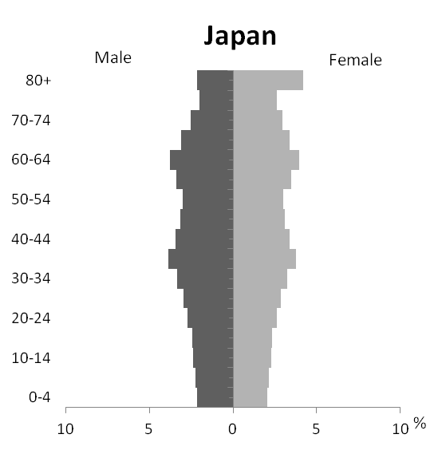
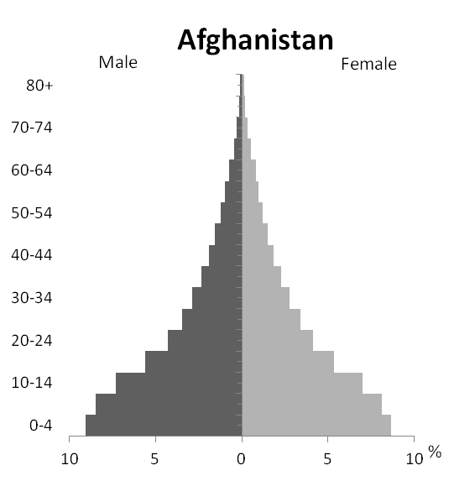
Population ageing – dynamic process
GENERATIONS
PROCESS

Slide 5
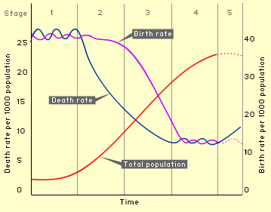
Demographic Transition and Population Ageing
Population ageing

Slide 6
MEASURING POPULATION AGEING

Slide 7
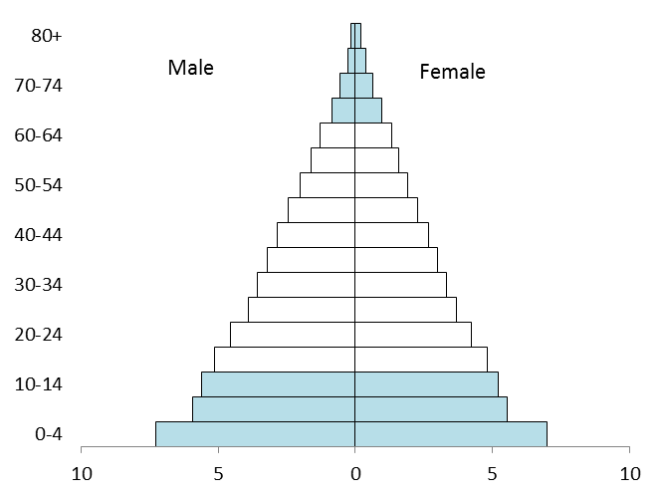
Measures based on age thresholds: 15 & 65
3 AGE-BASED MEASURES
Proportion aged 65+
Old-age dependency ratio
65+ / 15-64
Old-age share of dependency
65+ / (65+ & 0-14)
Old age: 65+
Working age: 15-64
Childhood: 0-14

Slide 8
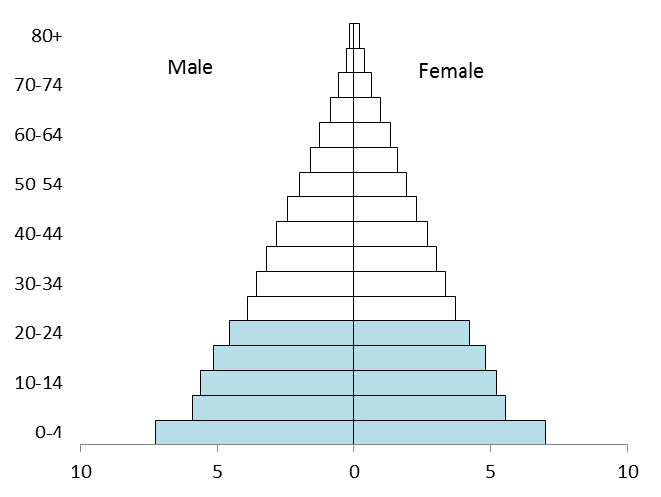
Measures based on percentile thresholds:
25, 50, 75 etc
PERCENTILE-BASED MEASURES
Median age
Oldest quartile
Youngest quartile
50%
50%

Slide 9
TRENDS IN ASIA – EXPLORING HETEROGENEITY

Slide 10
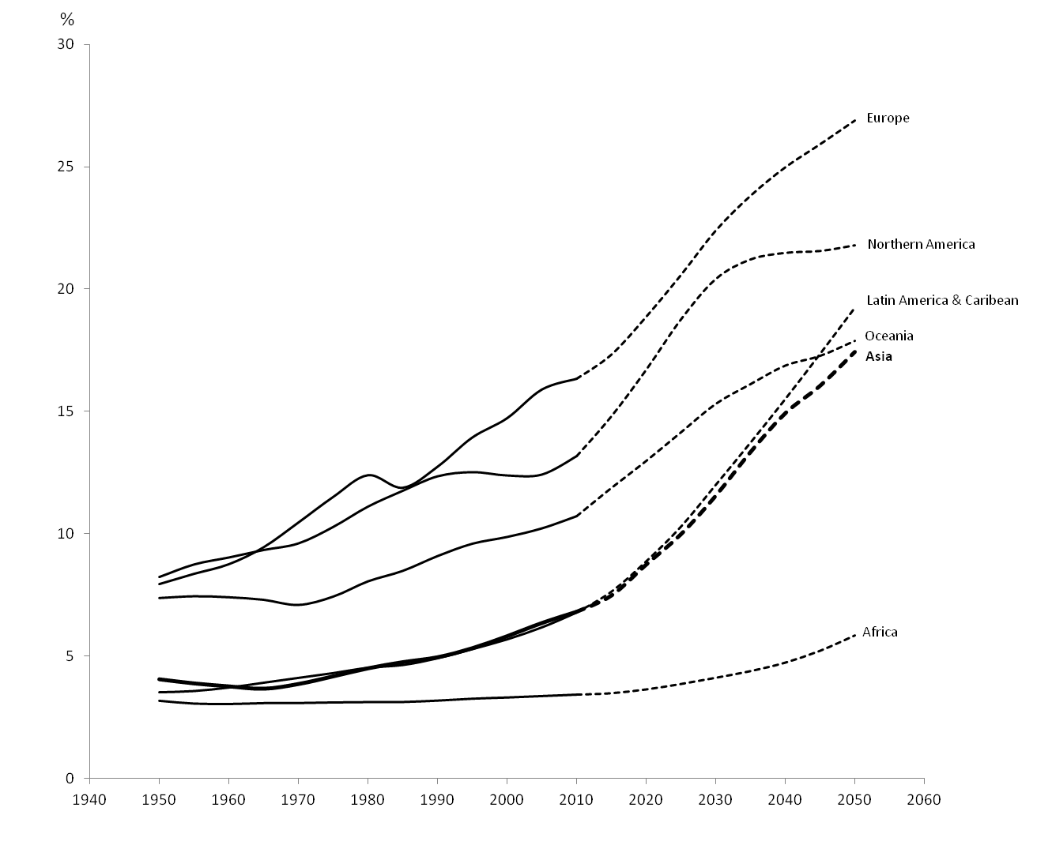
Population aged 65+ as a percentage of total population, world regions, 1950-2050
Asia
Notes: Solid lines are estimates (1950-2010); dashed lines are projections (2011-2050).
Source: United Nations (2012) World Population Prospects: 2012 Revision. New York: UN.

Slide 11
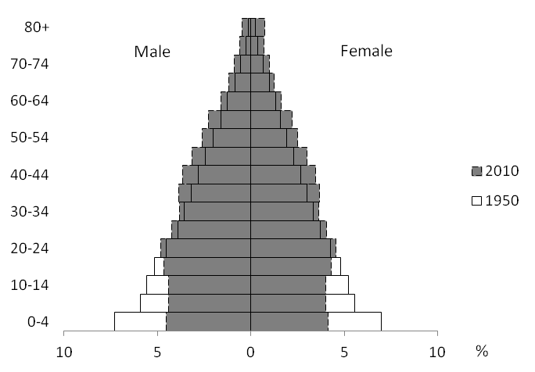
Age-sex structure of total population of Asia, 1950 and 2010

Slide 12
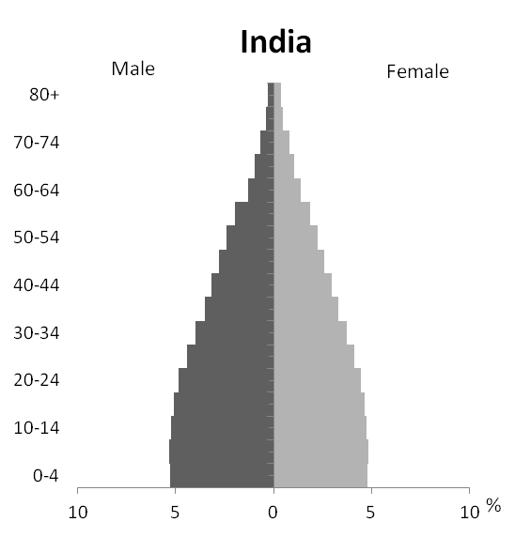
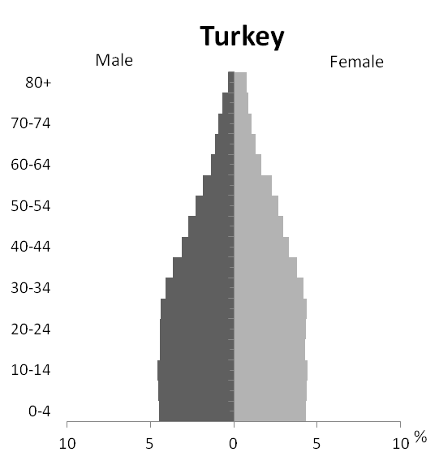
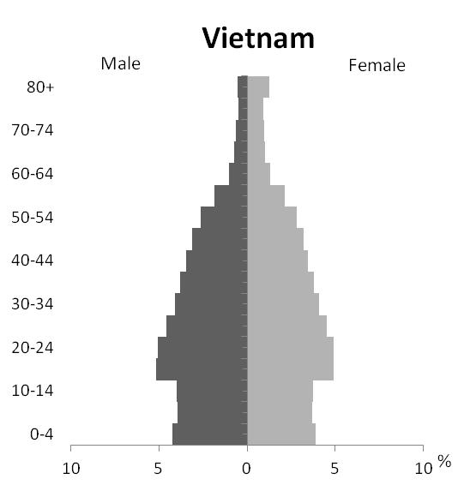
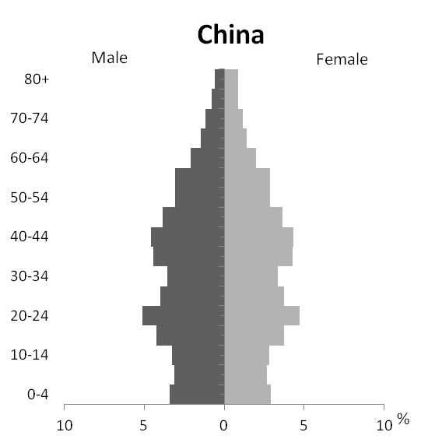

Slide 13
EASTERN | SOUTH-CENTRAL | SOUTH-EASTERN | WESTERN
ASIA | ASIA | ASIA | ASIA
 | South Asia |  | Arab
China | Afghanistan | Brunei | Bahrain
Hong Kong | Bangladesh | Cambodia | Iraq
Japan | Bhutan | Indonesia | Jordan
Macao | India | Laos | Kuwait
North Korea | Iran | Malaysia | Lebanon
Mongolia | Maldives | Myanmar | Oman
South Korea | Nepal | Philippines | Qatar
Taiwan | Pakistan | Singapore | Saudi Arabia
 | Sri Lanka | Thailand | Palestine
 |  | Timor-Leste | Syria
 |  | Vietnam | United Arab Emirates
 |  |  | Yemen
 | Central Asia |  | Non-Arab
 | Kazakhstan |  | Armenia
 | Kyrgyzstan |  | Azerbaijan
 | Tajikistan |  | Cyprus
 | Turkmenistan |  | Georgia
 | Uzbekistan |  | Israel
 |  |  | Turkey

Slide 14
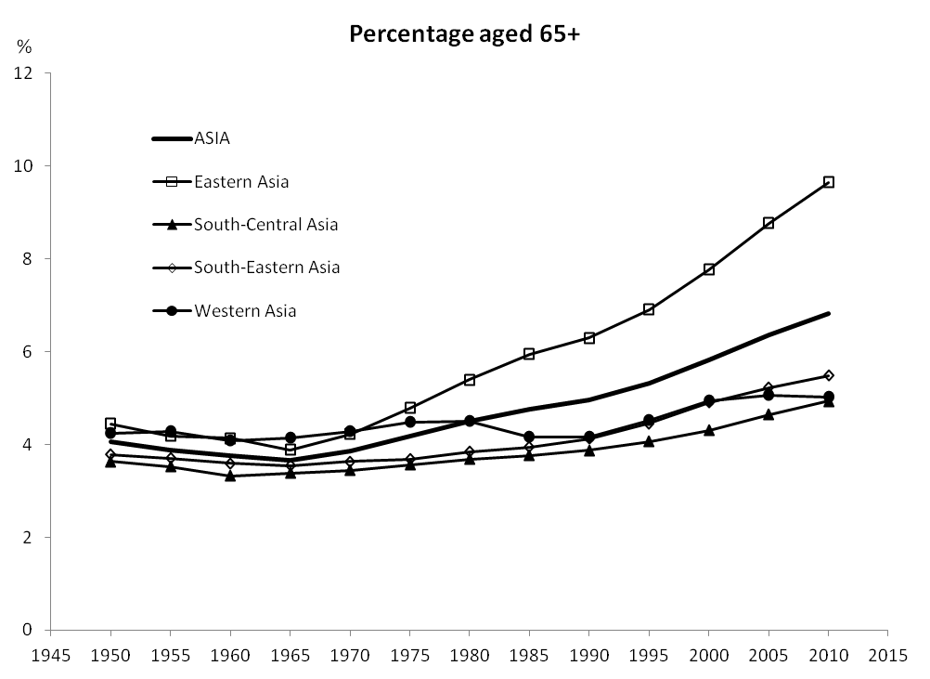
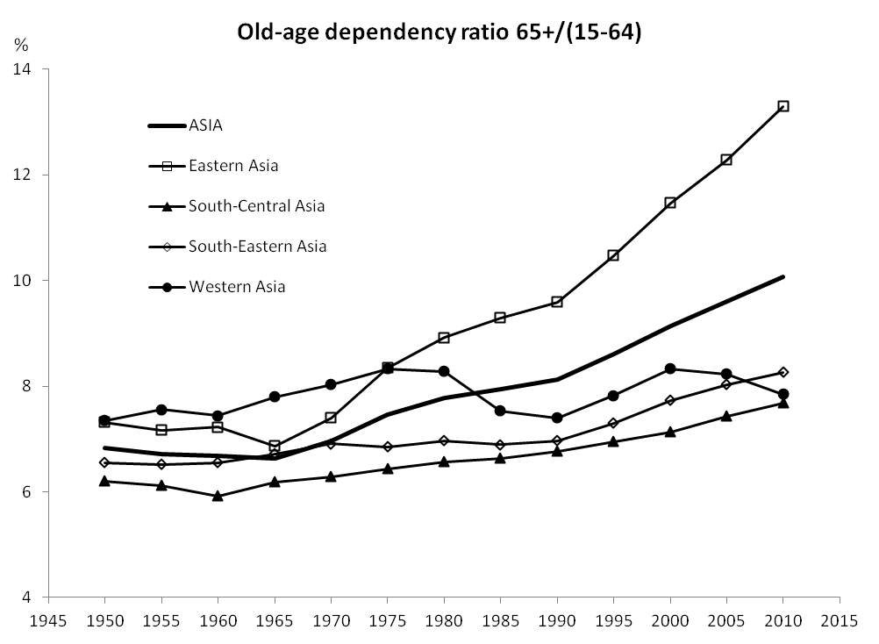
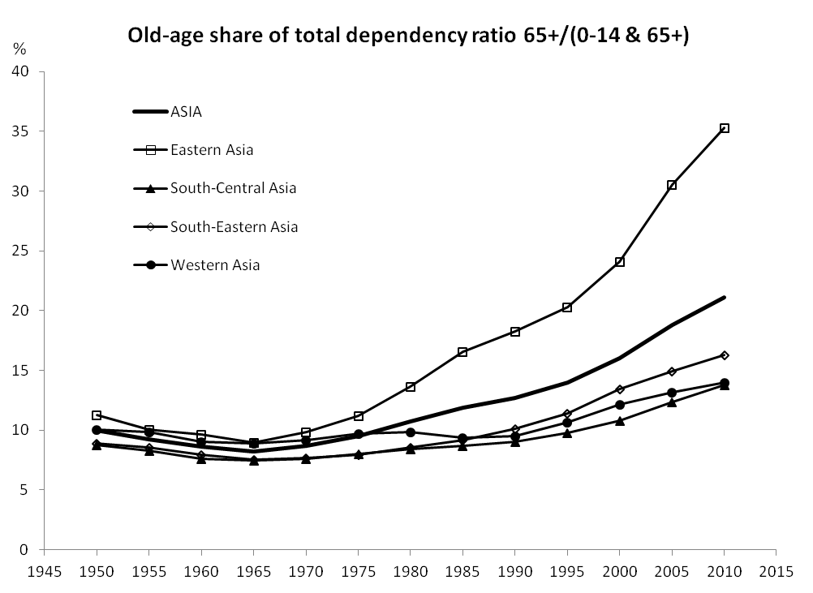
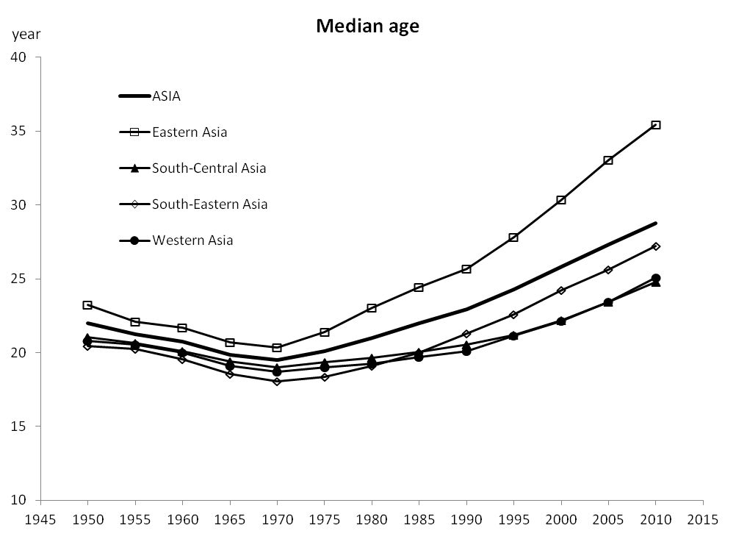
Indicators of ageing, 1950-2010
% aged 65+
Old-age dependency ratio
Old-age share of total dependency
Median age

Slide 15
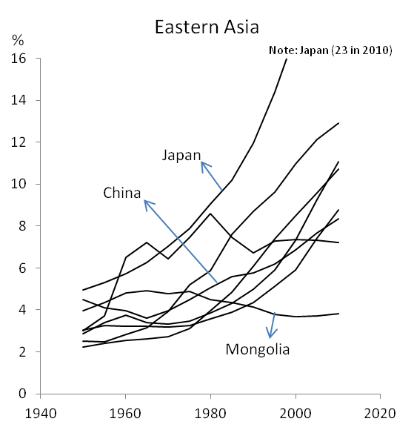
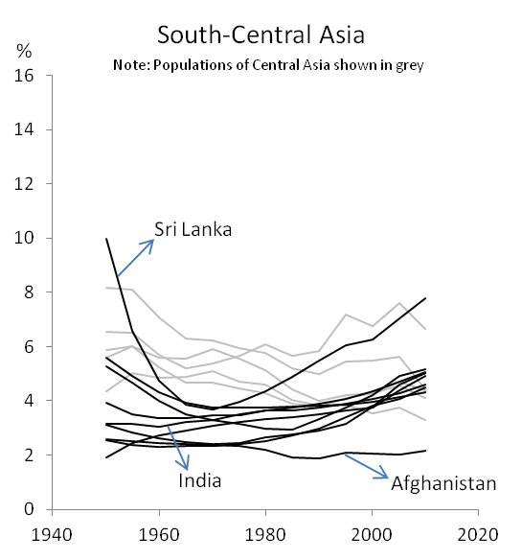
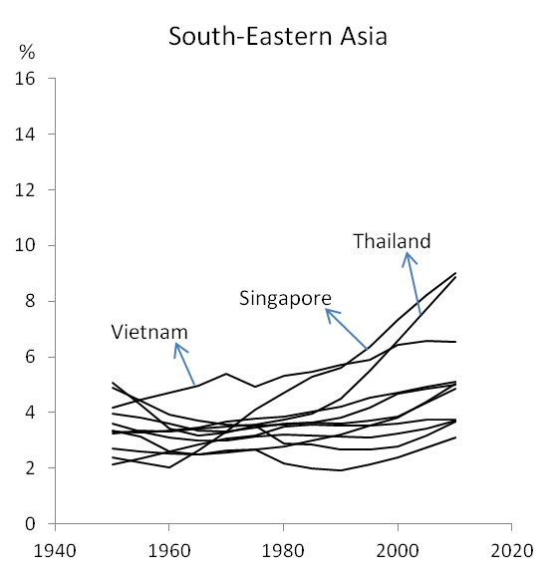
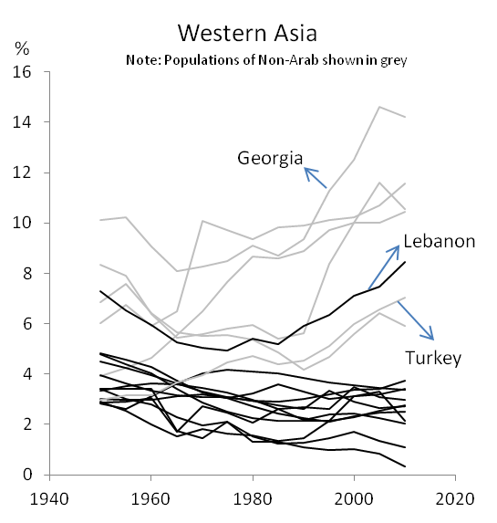
% 65+

Slide 16
% 65+

Slide 17
% 65+

Slide 18
% 65+

Slide 19
% 65+

Slide 20

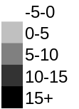

Change in median age 1950-2010
years

Slide 21
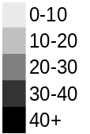
Old age share of total dependency, 2010
per 100

Slide 22
Old Age Dependency Ratio, 2010
per 100

Slide 23
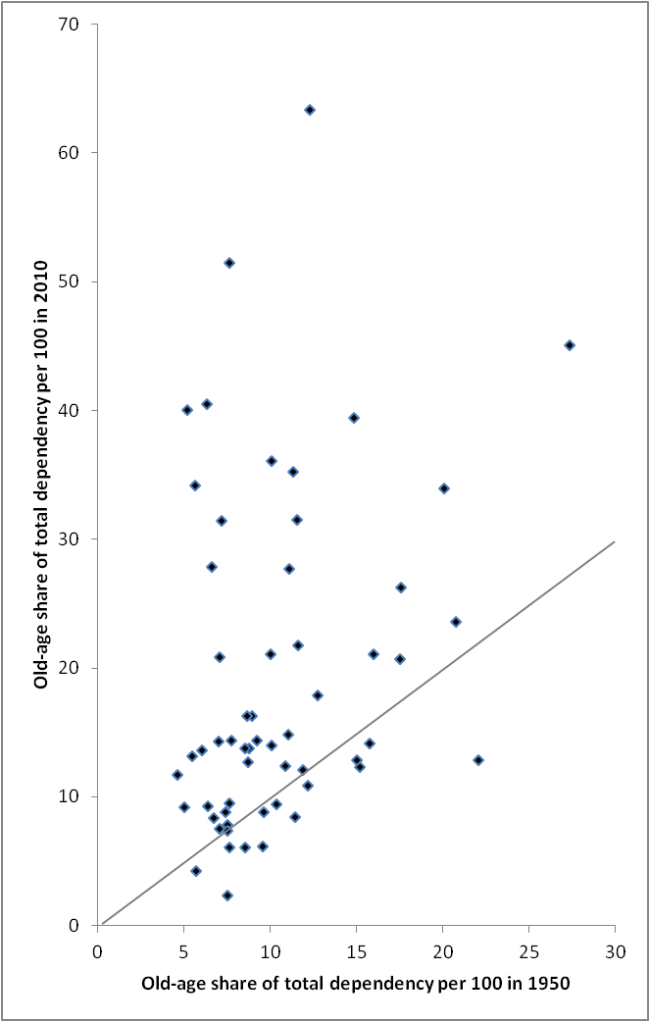
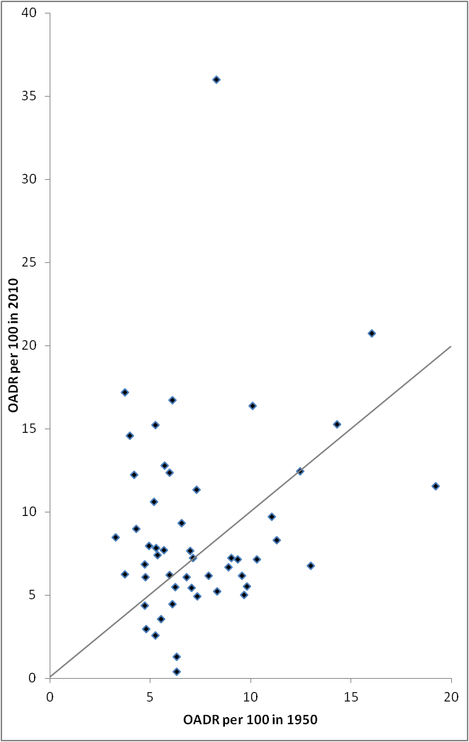
1950 and 2010
OASD
65+ /
(65+ & 0-14)
OADR
65+ /
(15-64)

Slide 24
THE CHALLENGES – SOCIAL SECURITY IN OLD AGE

Slide 25
Population ageing and the family
Intergenerational contract
Weakened by demographic transition, population ageing, economic and social change
  Demography: 4-2-1 problem
  Economic: working generation ‘squeezed’
  Social: status of women and parental care
Adaptation - filial piety maintained

Slide 26
Population ageing and the state
Old-age social security - slow development and inadequate
Contributory social security schemes:
  Sustainability of defined benefit schemes?
  Adequacy of workers’ savings schemes?
  Partial coverage, inequity, low level of benefit
  Urgency, sustainability, longevity risk
Non-contributory social safety net

Slide 27
Family, state and elder well-being
Goal of old-age support is elder well-being
Interface between family and state determines level of support and its delivery
Renewed emphasis on co-residence
Well-being associated co-residence
Evidence of reduced poverty and improved well-being

Slide 28
Population ageing and society
Experience of population ageing derives from socio-economic context
Imperative to ‘get rich before getting old’
Transformation of intergenerational contract
  Heavy burden on working generation
  Older generation vulnerable to changes?
  Changing gender relations

Slide 29
The future of population ageing in Asia
Long- term process
By 2050, 17% aged 65+ in Asia
By 2050, 37% aged 65+ in Japan
The process ‘will’ end – demographic transition theory
Policies to increase fertility (mitigation) is not the solution
Adaptation is more viable: ‘enabling’ policies

Slide 30
Acknowledgments
Xiaoguang Jia provided research assistance for producing the figures under funding from the ARC Centre of Excellence in Population Ageing Research

